Slide 1
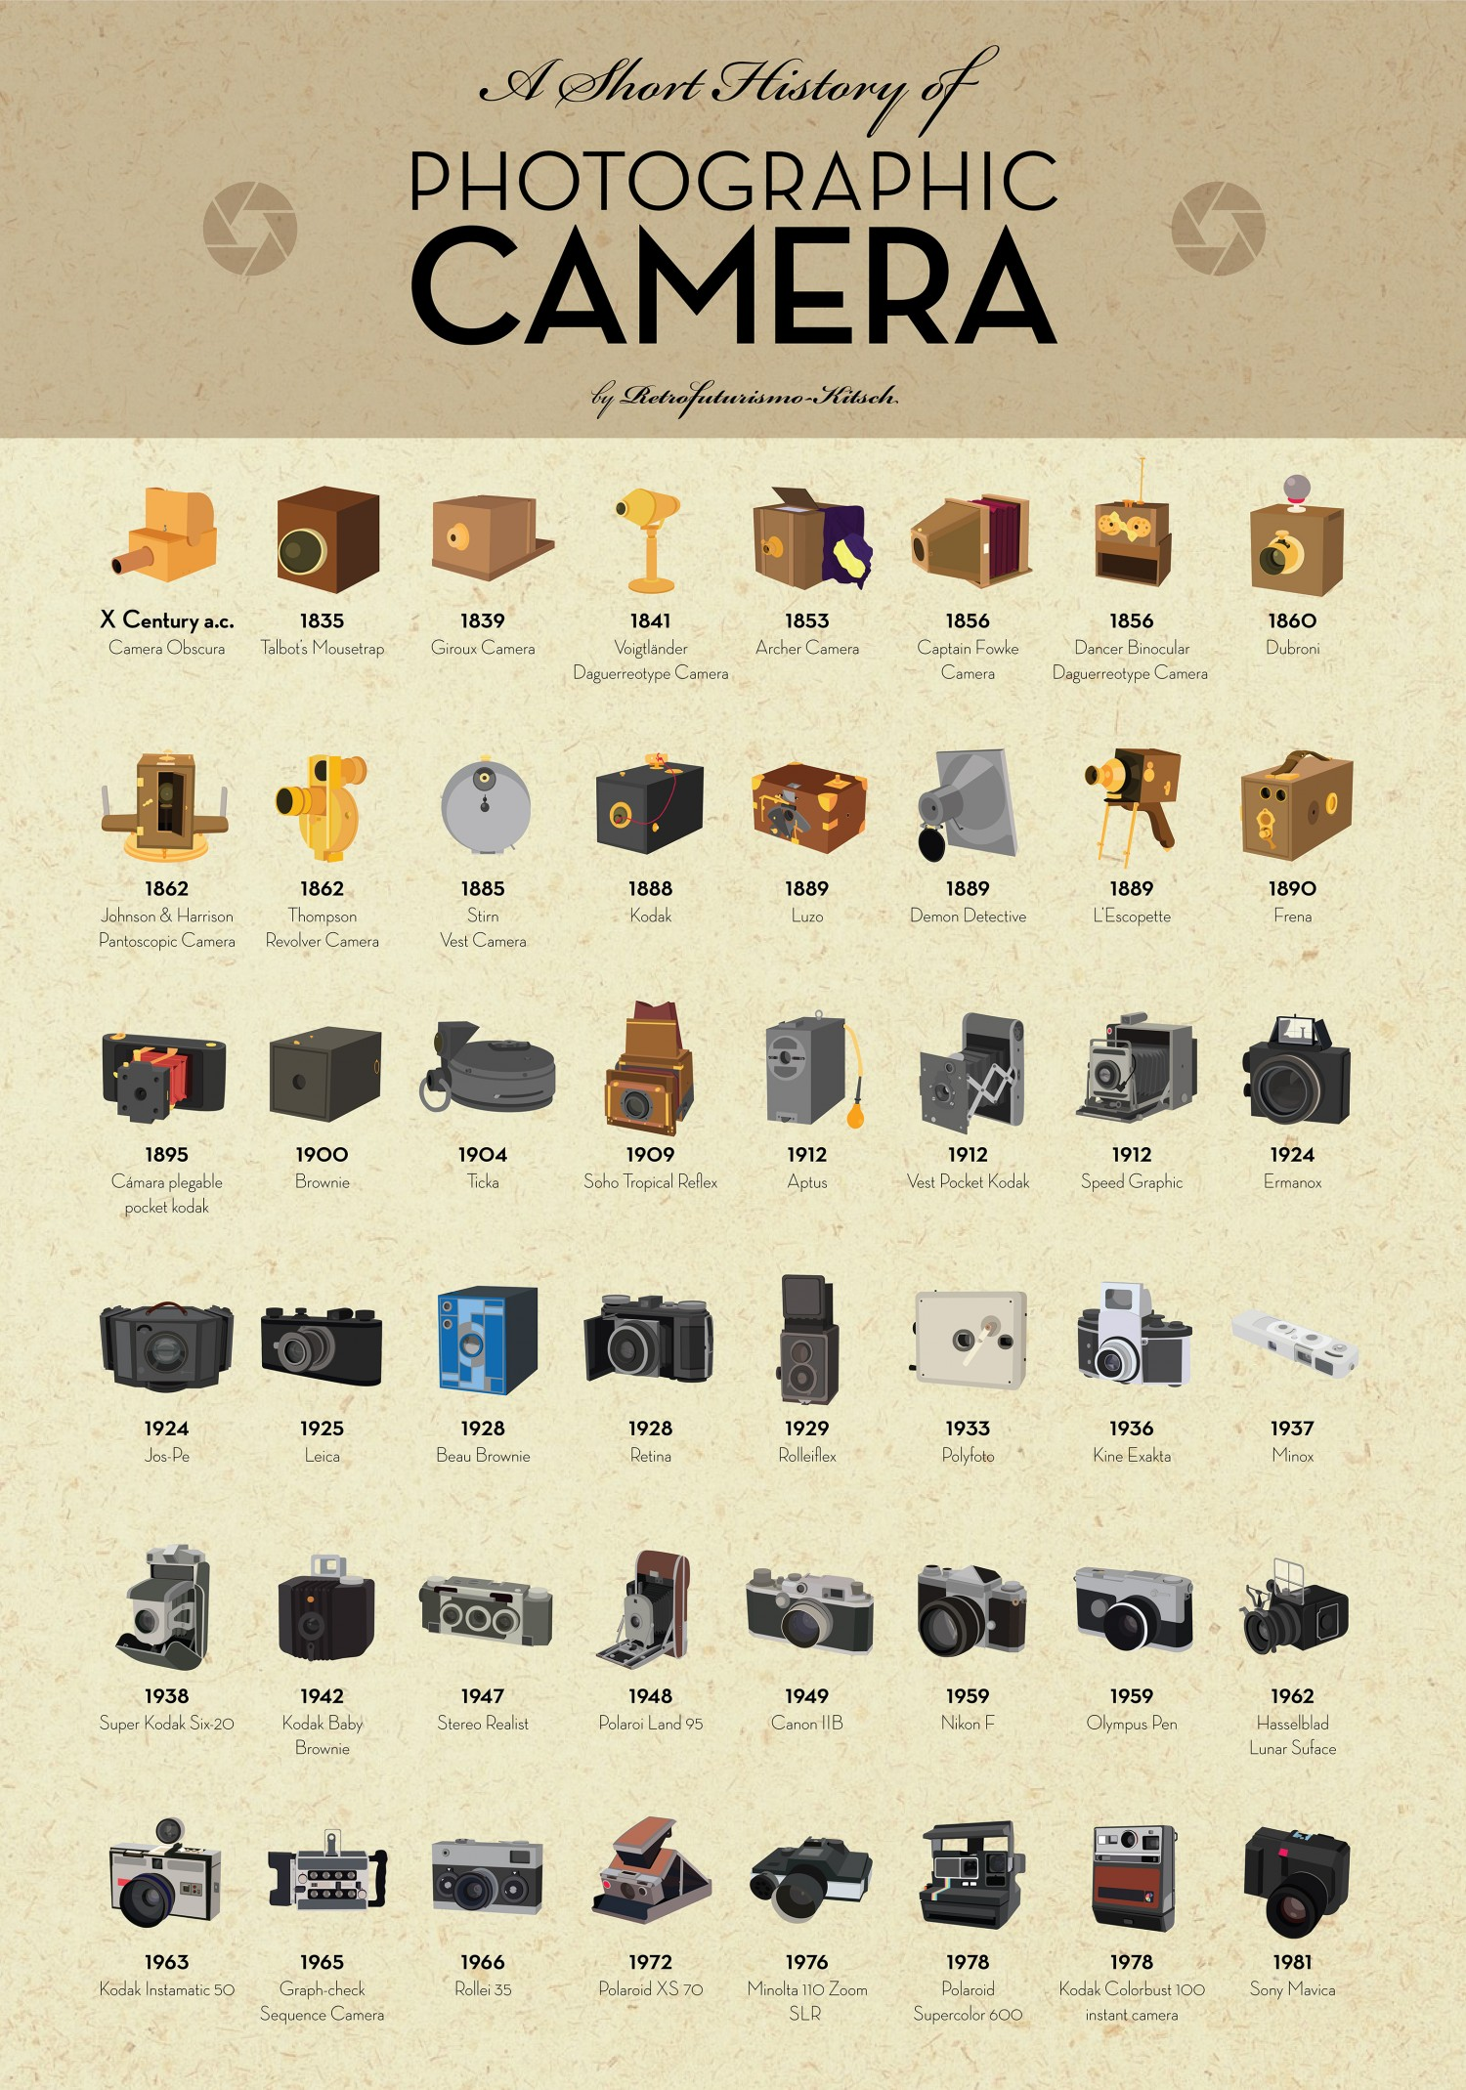
THE EVOLUTION OF CAMERAS

Slide 3
Intro
The technology that created the modern camera was created hundreds of years ago. Although they were far away from the cameras we know today, the technology was quite advanced for the time.

Slide 4
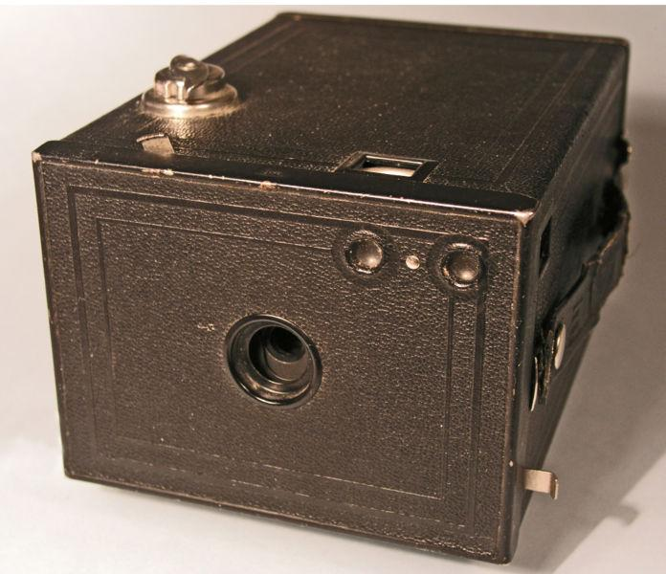
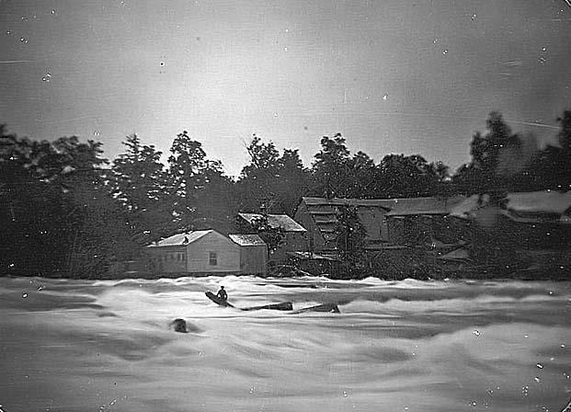
1885
In 1885, George Eastman created the first convenient camera for customers using roll film.
This is the first Kodak Camera.

Slide 5
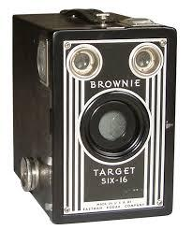
1901
Eastman expanded on his technologies and created the brownie. This camera was able to take snapshots that you could carry around.
fun fact: this camera did so well it kept being manufactured until the 1960’s

Slide 6
1914
Oskar Barnack experimented with 35mm film trying to put them into cameras to create still pictures rather than moving pictures. This film was originally only used for movies.
Due to the war, Barnack wasn’t able to experiment further until…

Slide 7
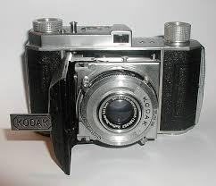
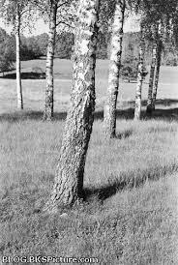
1934
The Kodak Company invented the Retina I. This camera had all the technology the newer cameras had at a cheaper price. This was the first camera to include 35mm film.

Slide 8
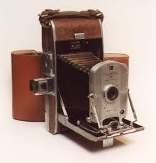
1948
The polaroid camera brought the capabilities of instant pictures to customers. Even though it was more expensive it was one of the best selling models

Slide 9
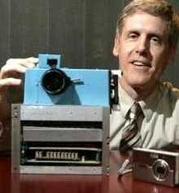
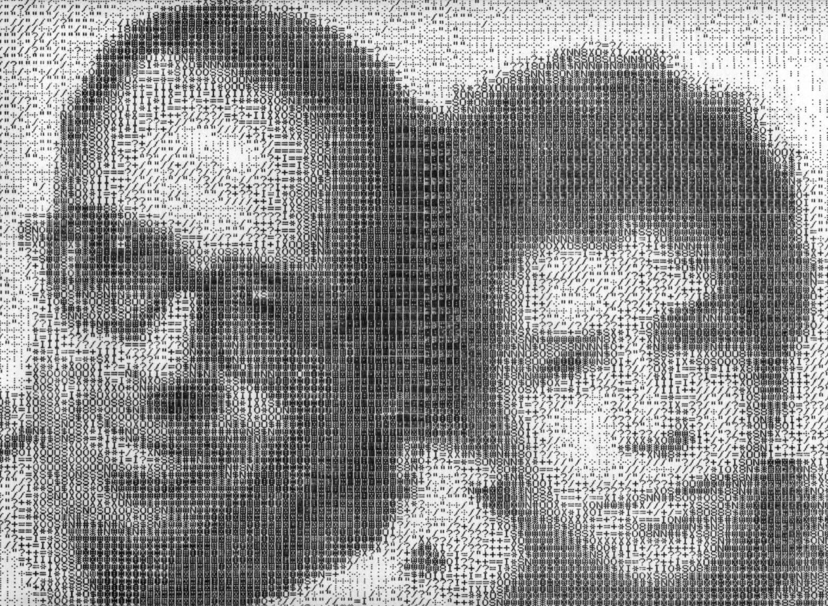
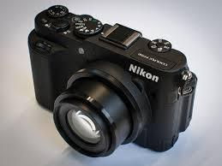
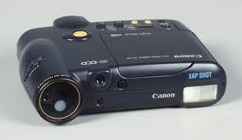
1972
The digital camera was created by Texas Instruments. This was only a prototype. The true digital camera was created 1988 in Japan and 1991 in America.

Slide 10
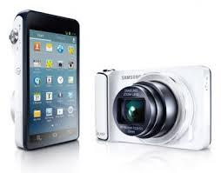
Today
There are a variety of cameras. Cameras are so common most people have them in their pockets or on their phones.

Slide 11
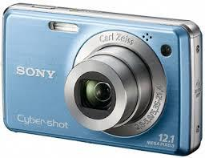
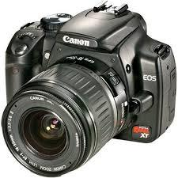
Types of Cameras Today
Point and Shoot Cameras | These cameras are very convenient for the average person allowing them to snap pictures quickly and easily
(D)SLR Cameras | These cameras allow people to adjust the focus, shutter speed, and size of aperture. This allows people to get a more accurate vision.

Slide 12
COOL PARTY
GO LEARN SOMETHING

