Slide 1
Rules of Composition

Slide 2
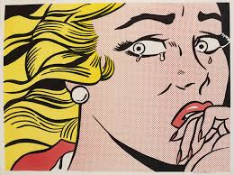
Fill the Frame
Give your subject prominence. Choosing more negative space is ok, but distancing the subject too much causes a boring and unfocussed composition
decide how important your subject is and then give him/her a ratio of the frame that is directly related to his/her importance.
Crying Girl
Roy Lichtenstein
1963

Slide 3
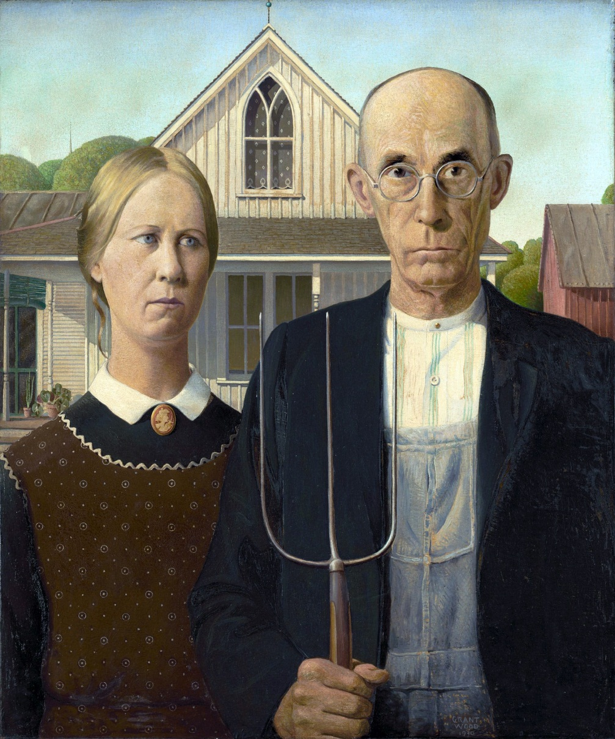
American Gothic by Grant Wood
1930

Slide 4
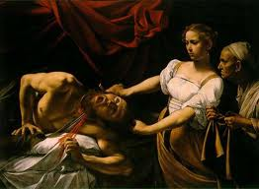
Rule of Odds
The eye tends to be more comfortable with images that contain an odd number of elements rather than an even number.
The human eye will naturally wander towards the center of a group. If there’s empty space there, then that’s where the eye will fall. You want your viewer to look at a subject, not at an empty space.
Judith Beheading Holofernes
Caravaggio
1598-1599

Slide 5
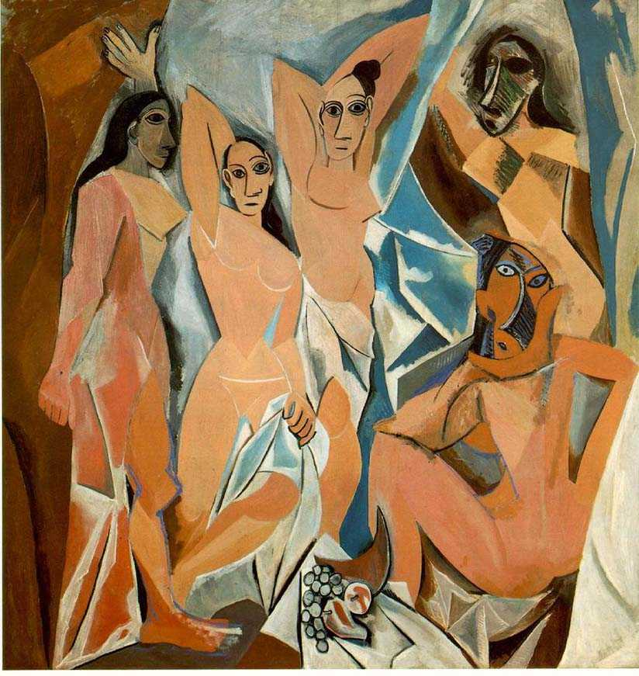
Les Desmoiselles d’Avignon
Pablo Picasso
1907

Slide 6
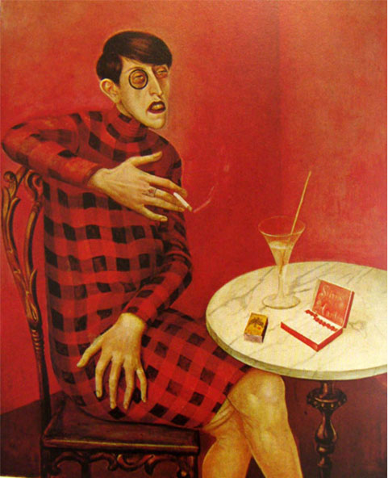
Rule of Thirds
use your eye to roughly divide your image with four lines into nine equal-sized parts, then place your subject at the intersection of those lines.
“Portrait of the Journalist Sylvia Von Harden” by Wilhelm Heinrich Otto Dix 1926

Slide 7
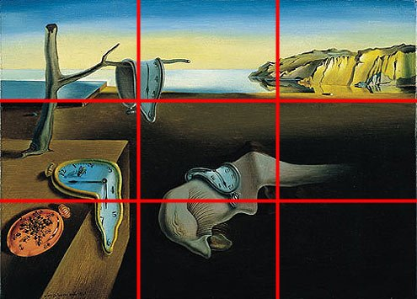
The Persistence of Memory
Salvador Dali
1931

Slide 8
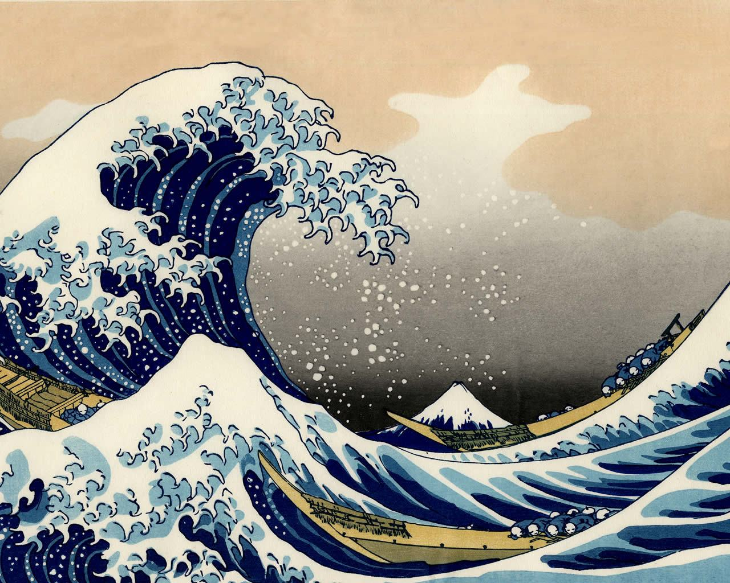
Great Wave off Kanagawa by Hokusai
1830-1833

Slide 9
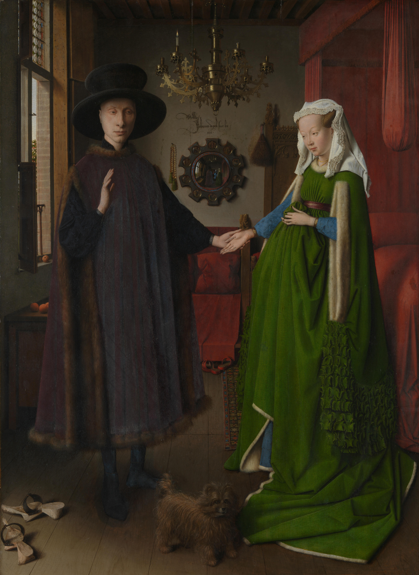
Leading Lines
When we look at a photo our eye is naturally drawn along lines.
By thinking about how you place lines in your composition, you can affect the way we view the image, pulling us into the picture, towards the subject, or on a journey "through" the scene.
There are many different types of line - straight, diagonal, curvy, zigzag, radial etc - and each can be used to enhance our photo's composition.
Arnolfini Portrait
Jan van Eyck
Early Renaissance

Slide 10
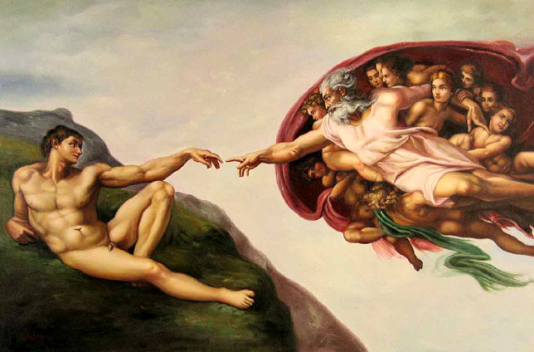
The Creation of Adam
Michaelangelo
1512

Slide 11
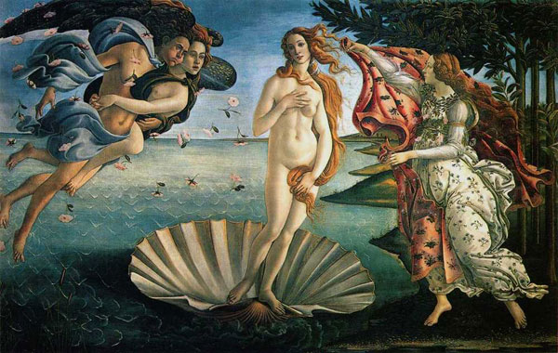
The Birth of Venus
Sandro Botticelli
1486

Slide 12
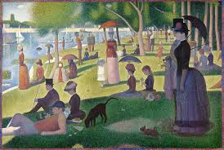
Vary Your Sizes
A Sunday Afternoon on the Island of La Grande Jatte
Georges Seurat
1884-1886
Add interest by varying the sizes of the objects you use in your composition

Slide 13
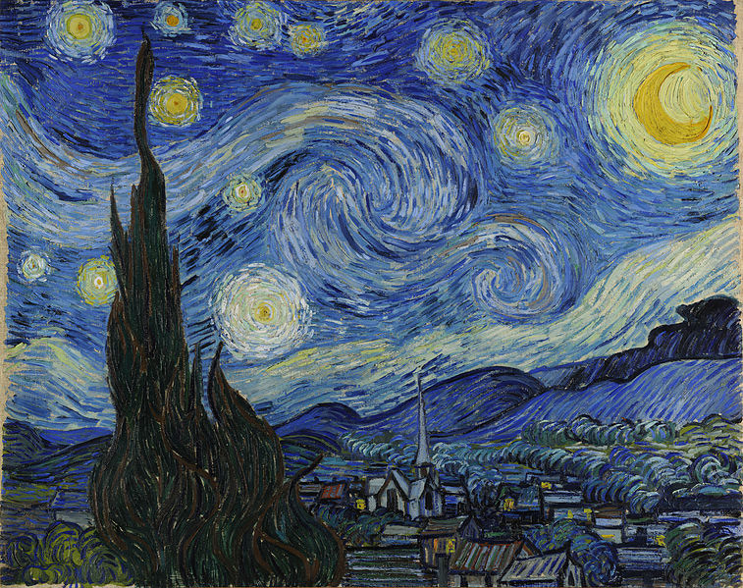
The Starry Night
Vincent van Gogh
1889

Slide 14
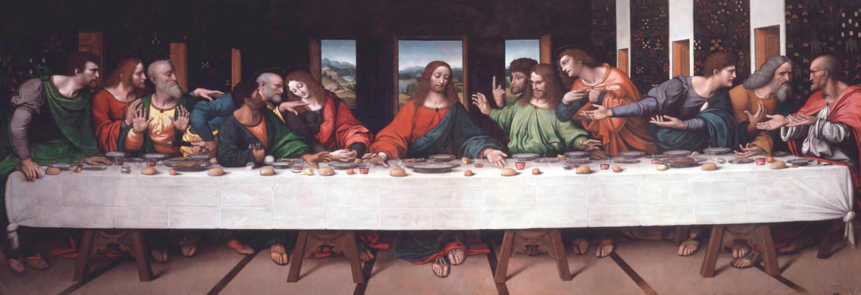
Mergers
The Last Supper
Leonardo da Vinci
1495-1498
1. Object to Object
space objects apart OR overlap them
never have objects awkwardly touching edge to edge

Slide 15
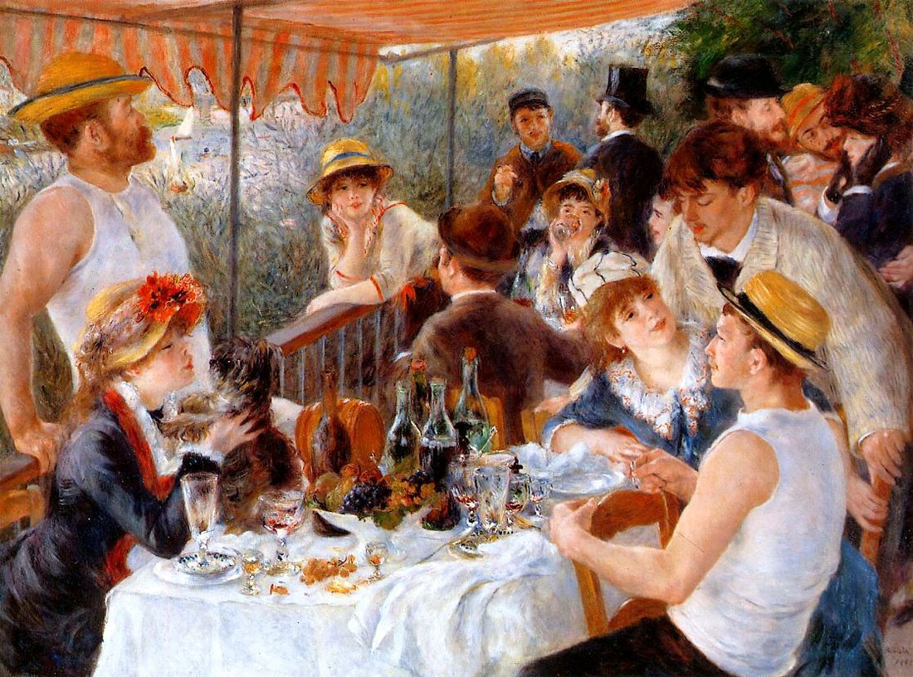
Luncheon of the Boating Party
by Pierre Auguste Renoir
1881

Slide 16
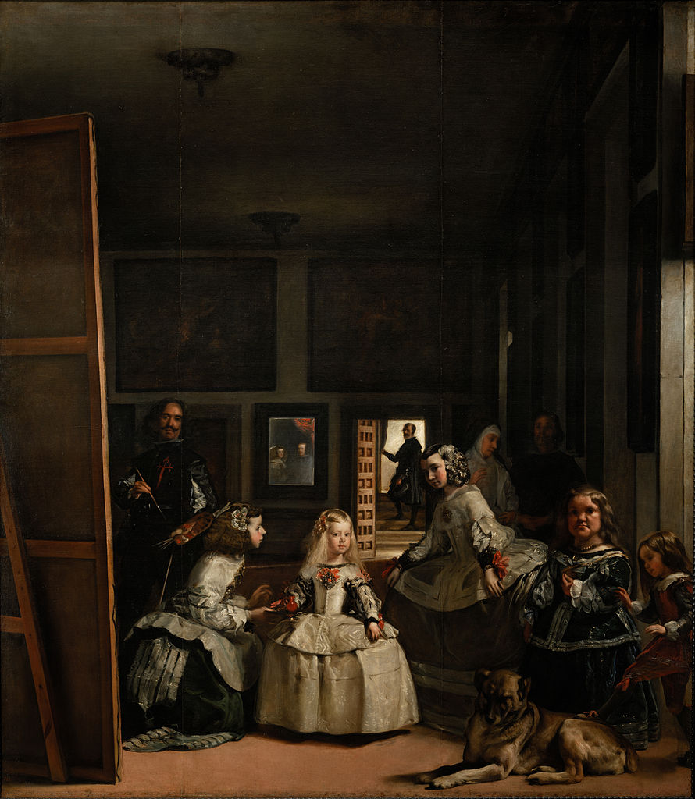
2. Object to Frame
- Never have an object touching the frame. Either overlap it (crop) or allow space between it and the edge
Las Meninas
Diego Velázquez
1656

Slide 17
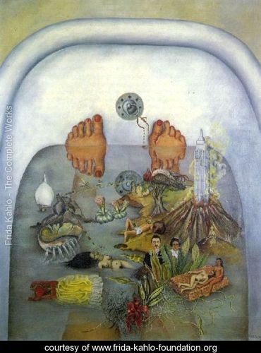
What the Water Gave me
Frida Kahlo
1938

