Slide 1
Purpose of Literary Devices

Slide 2
Why do Authors Use Devices?
Literary devices are the tools and techniques of language
that authors use to add layers of meaning. Rather than
simply stating the facts, authors hint at and disguise some
of it, so that the reader must figure things out for
him/herself (showing not telling).
The are used to....
keep their readers interested
add beauty to the writing.
By making personifications, allusions, metaphors, etc. the writing becomes rich and meaningful and evokes strong feelings in the readers.

Slide 3
Let’s Look at some Specifics:
Alliteration
Personification
Simile
Metaphor
Onomatopoeia

Slide 4
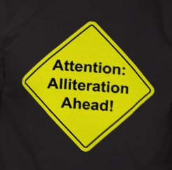

Slide 5
Alliteration
the repetition of sounds in nearby words
*draws attention to and emphasizes a phrase
*adds focus and drama
". . . neither of those can feel stranger and stronger emotions than the man does, who for the first time finds himself pulling into the charmed, churned circle of the hunted sperm whale."
Moby Dick

Slide 6
Alliteration
the repetition of sounds in nearby words
*makes the reader read faster, thereby adding a sense of speed and intensity to the sentence.
“The railroad tracks ran right through the center of town.”

Slide 7
Alliteration
the repetition of sounds in nearby words
*adds to theme, mood, etc.
Then leaf subsides to leaf. So Eden sank to grief, So dawn goes down to day. Nothing gold can stay.
“Nothing Gold Can Stay” by Robert Frost

Slide 8
Alliteration
the repetition of sounds in nearby words
*can just be plain fun
Betty Botter bought some butter, but, she said, the butter’s bitter; if I put it in my batter it will make my batter bitter, but a bit of better butter will make my batter better. So she bought a bit of butter better than her bitter butter, and she put it in her batter and the batter was not bitter. So ’twas better Betty Botter bought a bit of better butter.

Slide 9
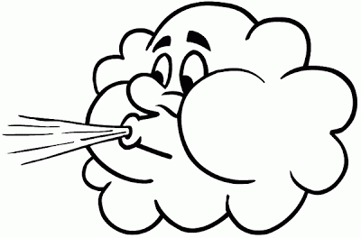
Personification

Slide 10
Personification
Personification is giving human qualities to inhuman or inanimate objects.
*makes situations more relatable
“The parrot chided him each time he sneaked through the door.”

Slide 11
Personification
Personification is giving human qualities to inhuman or inanimate objects.
*adds to mood
“Silence crept with shadowed footsteps through my cornered mind.”

Slide 12
Personification
Personification is giving human qualities to inhuman or inanimate objects.
*adds imagery
Awakening to the risen sun,
the rested trees stretched their limbs heavenward.

Slide 13
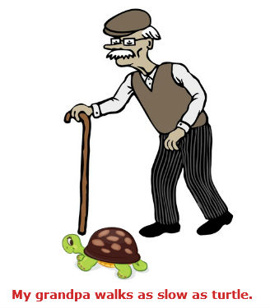
Simile

Slide 14
Simile
A comparison of dissimilar things which uses 'like' or 'as'.
*adds to depth and clarification
of meaning
"It is all, God help us, a matter of rocks. The rocks shape life like hands around swelling dough." Annie Dillard, "Life on the Rocks: The Galápagos"

Slide 15
Simile
A comparison of dissimilar things which uses 'like' or 'as'.
*adds to imagery
"My face looks like a wedding-cake left out in the rain." W.H. Auden

Slide 16
Simile
A comparison of dissimilar things which uses 'like' or 'as'.
*adds to mood and theme
"Humanity, let us say, is like people packed in an automobile which is traveling downhill without lights at terrific speed and driven by a four-year-old child. The signposts along the way are all marked 'Progress.'"
Lord Dunsany

Slide 17
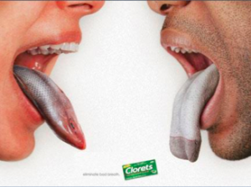
Metaphor

Slide 18
Metaphor
A comparison of dissimilar things without using 'like' or 'as'.
*adds to depth and clarification
of meaning in a more concrete way
The streets were a furnace, the sun an executioner.
Cynthia Ozick, "Rosa"

Slide 19
Metaphor
A comparison of dissimilar things without using 'like' or 'as'.
*adds imagery
in a more concrete way
Between the lower east side tenements the sky is a snotty handkerchief.
Marge Piercy, "The Butt of Winter"

Slide 20
Metaphor
A comparison of dissimilar things without using 'like' or 'as'.
*adds to mood and theme in a more concrete way
A man may break a word with you, sir, and words are but wind. Shakespeare, “The Comedy of Errors”

Slide 21
Metaphor
A comparison of dissimilar things without using 'like' or 'as'.
*allows for extended comparisons
Extended Metaphor is a comparison between two unlike things that continues throughout a series of sentences in a paragraph or lines in a poem.
“The teacher descended upon the exams, sank his talons into their pages, ripped the answers to shreds, and then, perching in his chair, began to digest.”

Slide 22
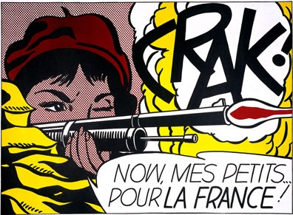
Onomatopoeia

Slide 23
Onomatopoeia
The formation or use of words such as buzz or murmur that imitate the sounds associated with the objects or actions they refer to.
*adds to imagery of the senses
by adding interest and depth
The pit bull yelped,
As the police took him away,
Never to growl again,
At us kids in play,
The shriek, squeal, and scream of the English bulldog,
As he pinned him that day,
Crunch,
His massive jaws, locked it's teeth
“The Pitbull” by D Alsup

Slide 24
Onomatopoeia
The formation or use of words such as buzz or murmur that imitate the sounds associated with the objects or actions they refer to.
*adds to mood
But the fact is I was napping, and so gently you came rapping, And so faintly you came tapping, tapping at my chamber door, That I scarce was sure I heard you' - here I opened wide the door; - Darkness there, and nothing more.
“The Raven” by Edgar Allen Poe

