Slide 1
Design & Technical Production
Stage-designing should be addressed to [the] eye of the mind. There is an outer eye that observes, and there is an inner eye that sees.
—Robert Edmond Jones

Slide 2
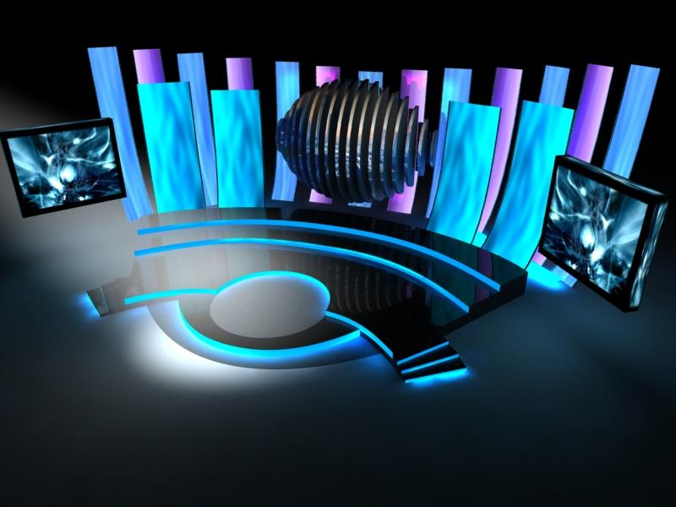
Design & Technical Production
The highly skilled creative people working in design and
production plan, construct and organize all the physical
details of a stage (film or TV) environment. These include:
Production Designer
Technical Director
Scene (Set) Designer
Properties Designer
Lighting Designer
Sound Designer
Costume Designer
Stage Manager

Slide 3
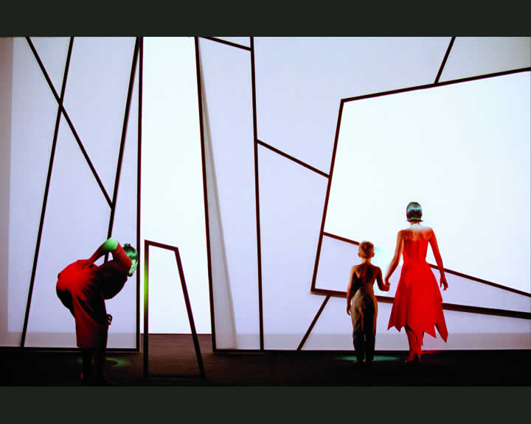
The Set Designer's Objective
Establishing Tone and Style
Robert Wilson
Woyzeck

Slide 4
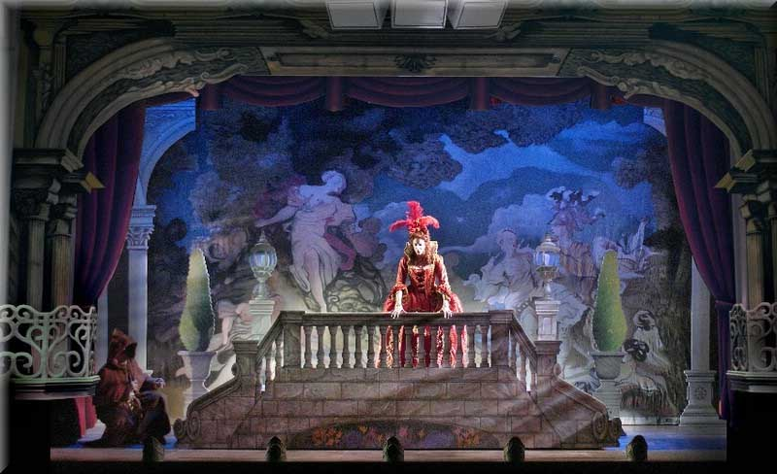
The Set Designer's Objective
Establishing Locale and Period

Slide 5
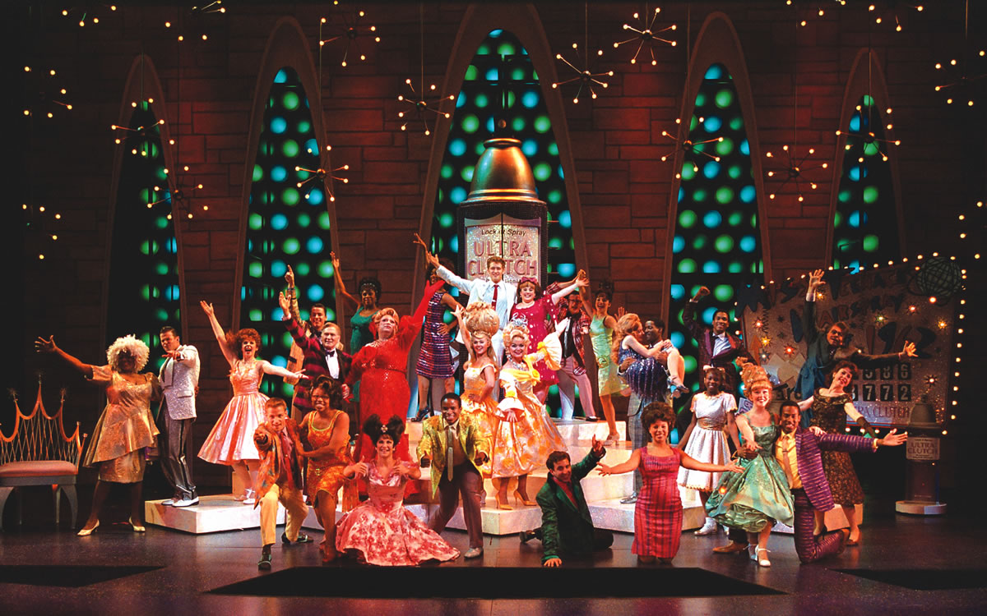
The Set Designer's Objective
Developing a Design Concept
A unifying idea carried out visually

Slide 6
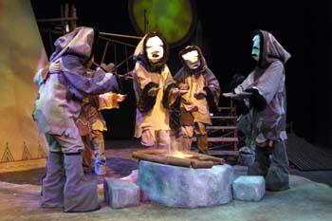
The Set Designer's Objective
Providing a Central Image or Metaphor
A literal central image: The fire pit
-Supported the idea of stories told around the fire.

Slide 7
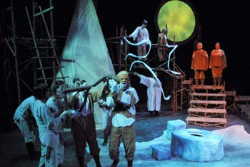
The Set Designer's Objective
Coordinating Scenery with the Whole
Crow and Weasel was a world where everything could transform. The set was flexible and supported many different uses.

Slide 8
Set/Scenic Designer
works with the director and other designers to establish an overall visual concept for the production and design the stage environment (and props).
develop a set of design drawings/renderings, creating scale models of the scenery, paint elevations and scale construction drawings as part of their communication with other production staff.

Slide 9
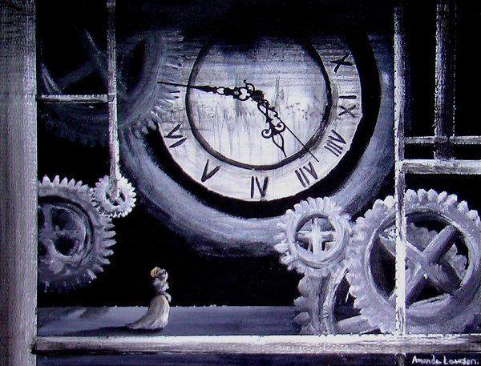
Set Drawings/Renderings

Slide 10
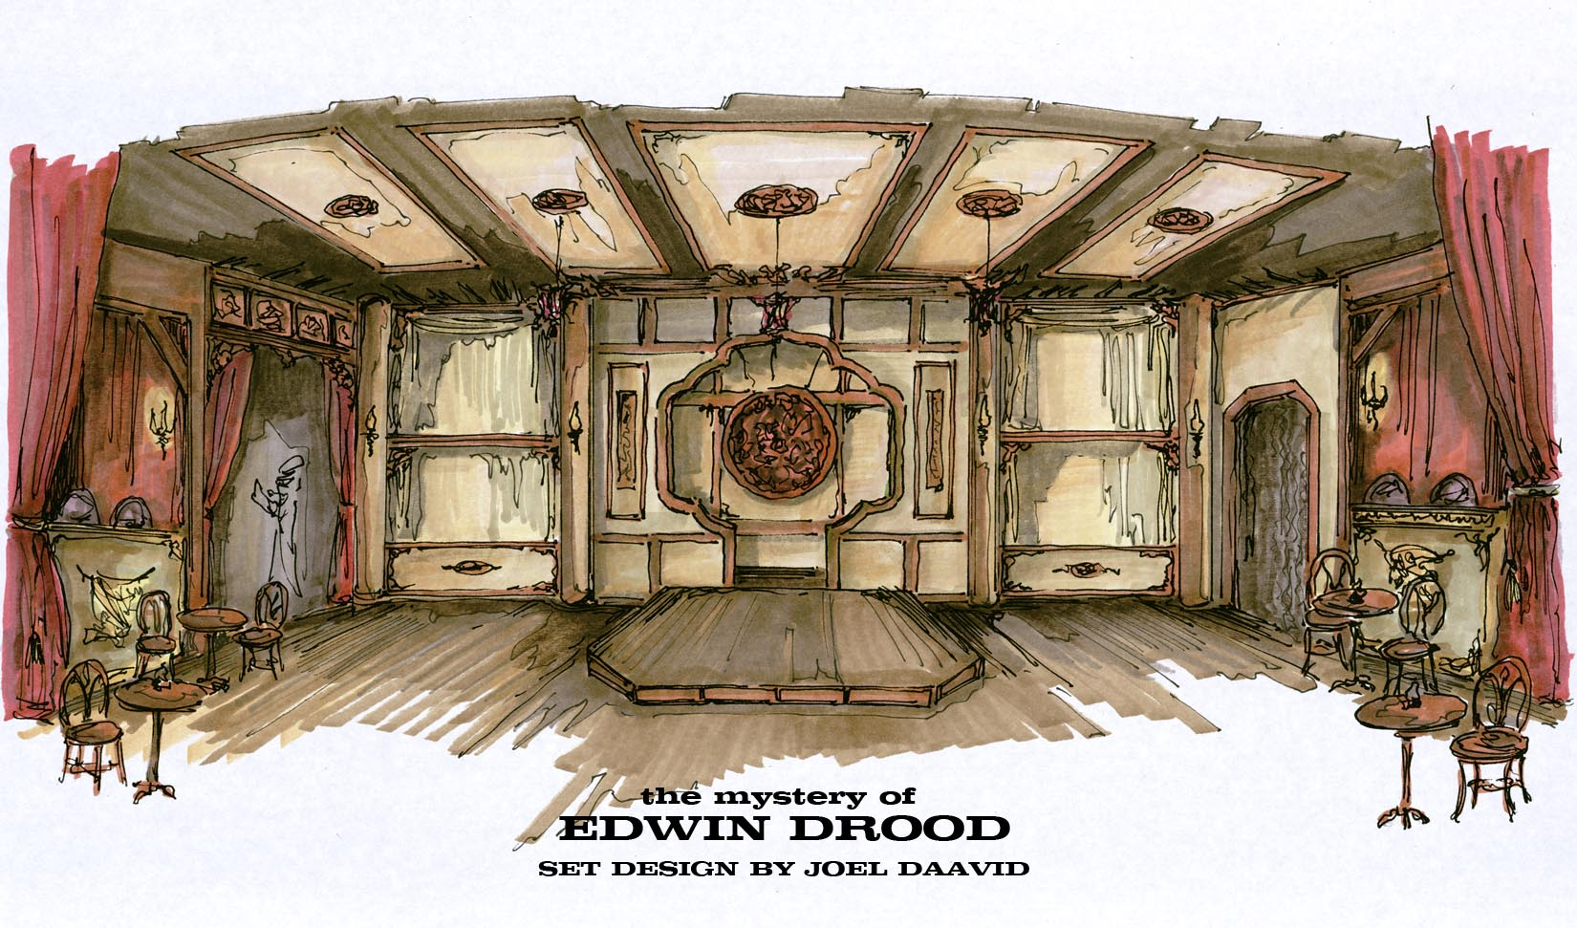
Set Drawings/Renderings

Slide 11
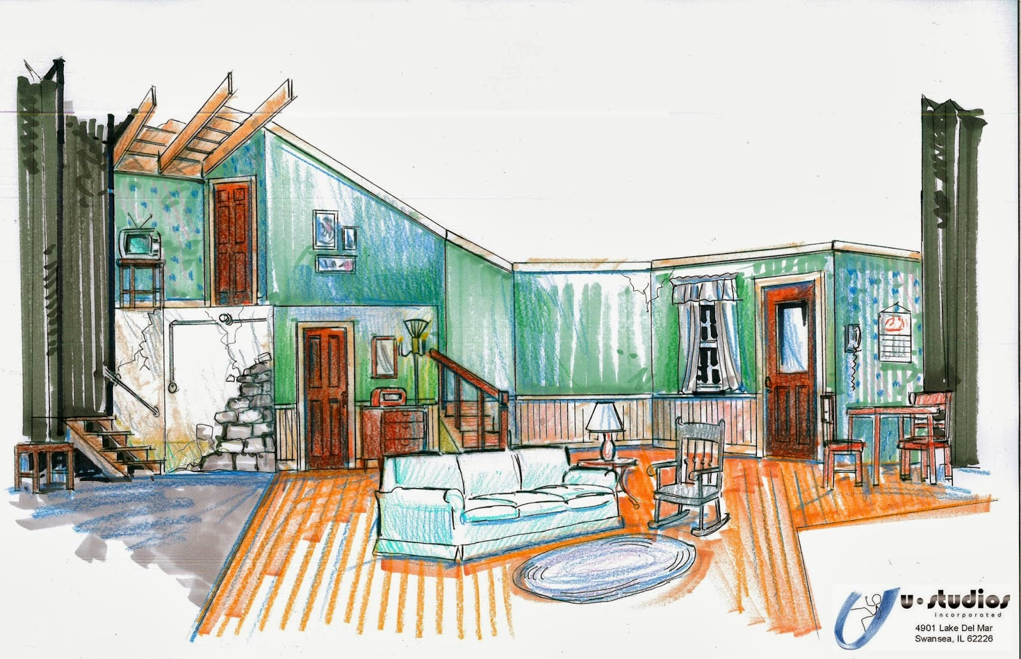
Set Drawings/Renderings

Slide 12
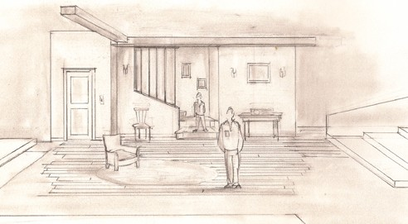
Set Drawings/Renderings

Slide 13
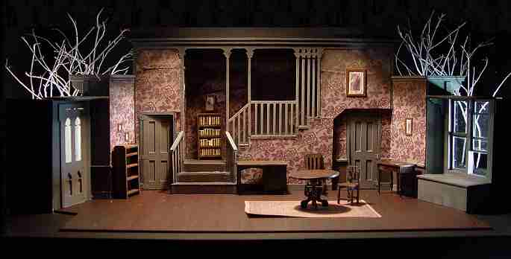
Set Design Models

Slide 14
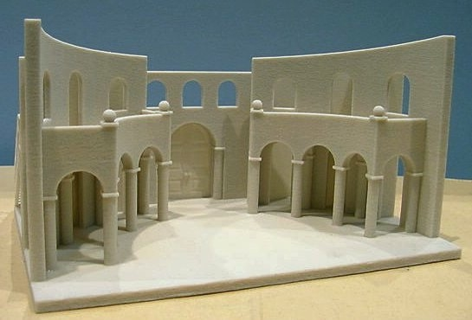
Set Design Models

Slide 15
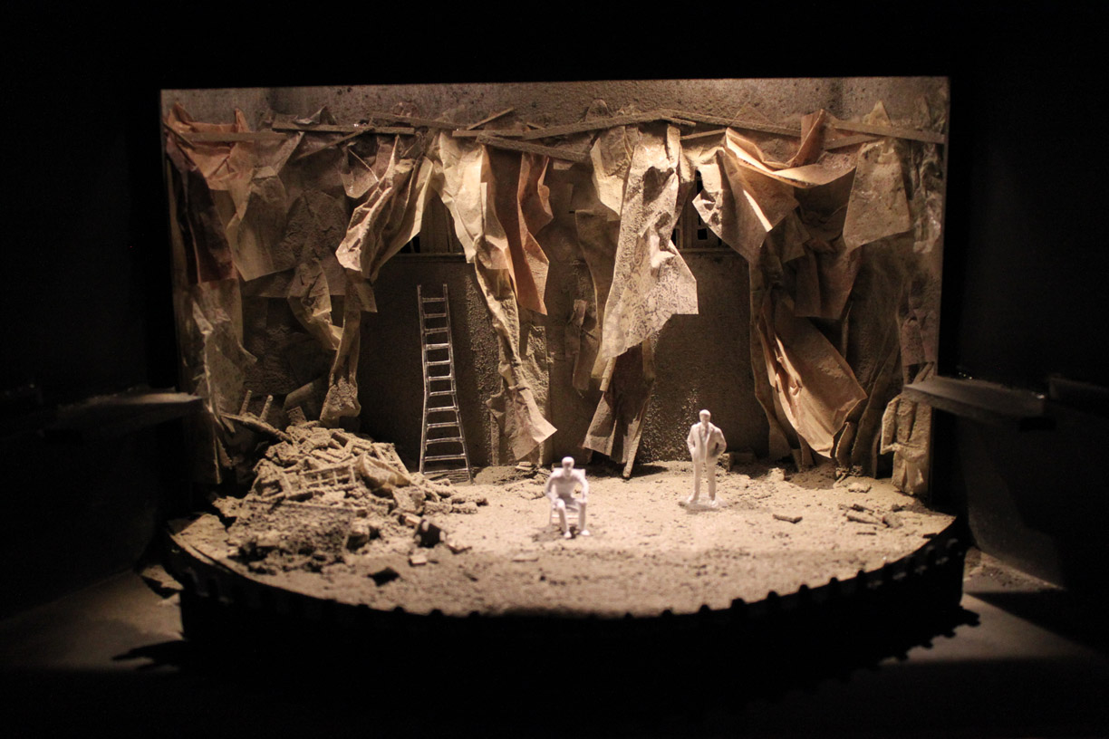
Set Design Models

Slide 16
Theatre Lighting Designer
(or LD) works with the
director, choreographer, set
designer, costume designer,
and sound designer to
create the lighting,
atmosphere, and time of
day for the production in
response to the text, while
keeping in mind issues of
visibility, safety, and cost.

Slide 17
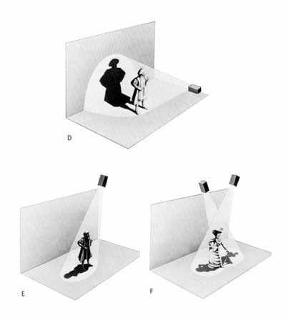
VISIBILITY
Making the performer visible is the most important aspect of lighting
The lights’ position, intensity and colour all require very careful consideration.
Notes:
This should be checked against the docuwhatevers

Slide 18
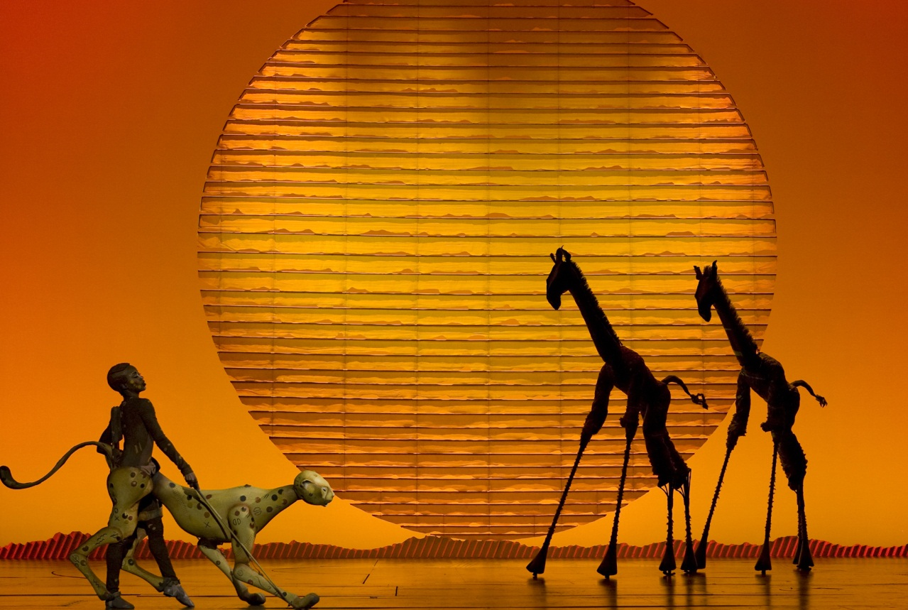
SETTING
Time of day and other lighting conditions such as a lightning storm, a warmly lit fireplace etc. are recreated on stage, making for a believable and more importantly, an understandable situation.

Slide 19
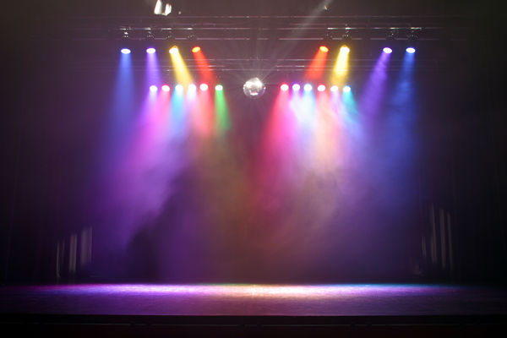
MOOD & ATMOSPHERE
Audiences normally connect certain lighting states with certain moods. Happy party atmosphere = bright, colourful light; soft glow from a Fireplace = romance; and so on.

Slide 20
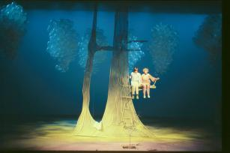
COMPOSITION
The act of painting a picture, in this case, with light.

Slide 21
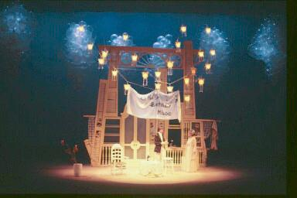
SELECTIVE FOCUS
Just as it is possible/necessary to make a performer visible, it is possible to make others appear less visible, and emphasize just one person. This ability to use selective visibility is very useful for getting the audience’s attention and focus where you want it.

Slide 22
BASIC QUALITIES OF LIGHT
The basic qualities of light are:
INTENSITY
FORM
COLOUR
DIRECTION and
MOVEMENT.
These are the lighting designer's tools.

Slide 23
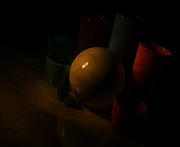
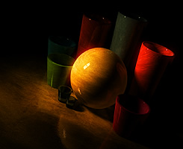
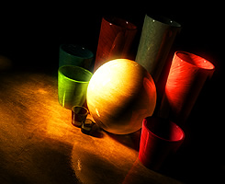
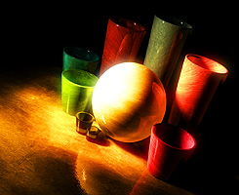
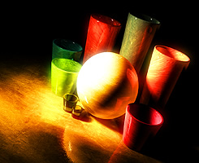
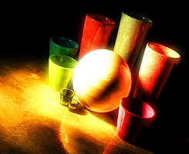
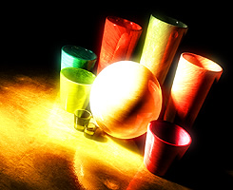
Light Intensity from too
Dark to too bright.

Slide 24
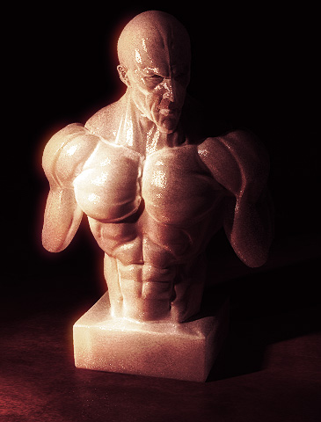
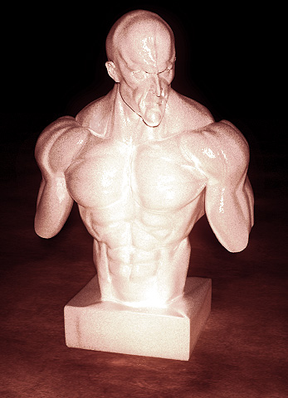
Direction
Lit from Left
Lit from behind camera

Slide 25
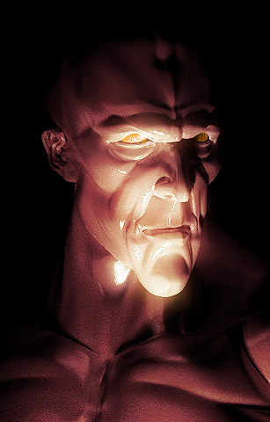
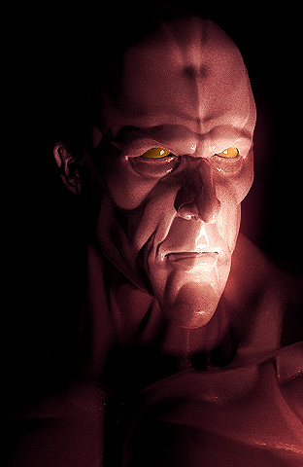
Mood
Menacing/Dramatic
Subtler Mood

Slide 26
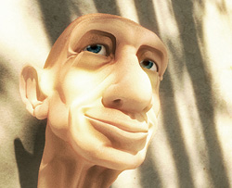
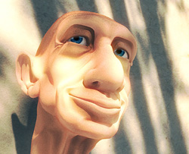
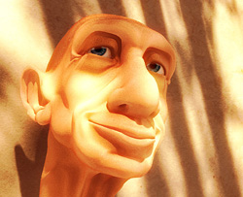
Colour (Seasons and Time of Day)
Early-Morning
Blue Tint
Mid-Day/Winter
Less blue tint
Even colors
Evening/Dusk
Summer
Orange Hues

Slide 27
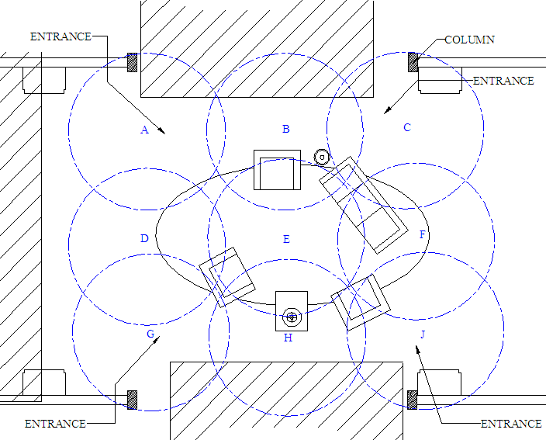
Traditional Lighting Method
Goal: general and even illumination of the principle acting areas of the stage.
Division of acting areas into lighting areas.

Slide 28
Traditional Lighting Method
Five light sources per lighting area.
Overlapping of beams to compensate for instrument characteristics.
Blending of complimentary colors to achieve white light.

Slide 29
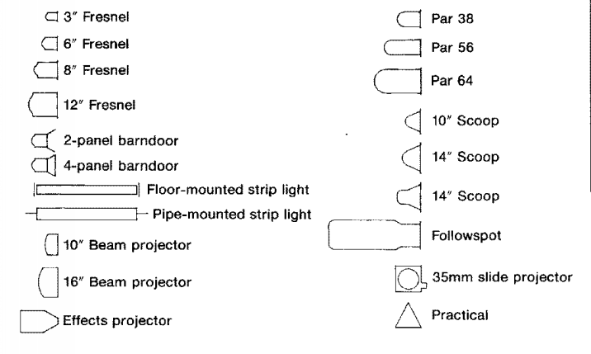
Lighting Legend
Drawings use particular symbols to indicate the type of lamp/light

Slide 30
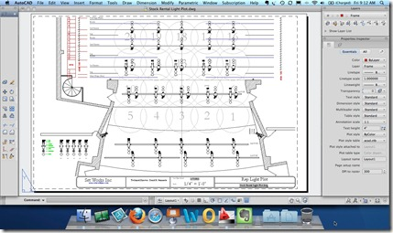
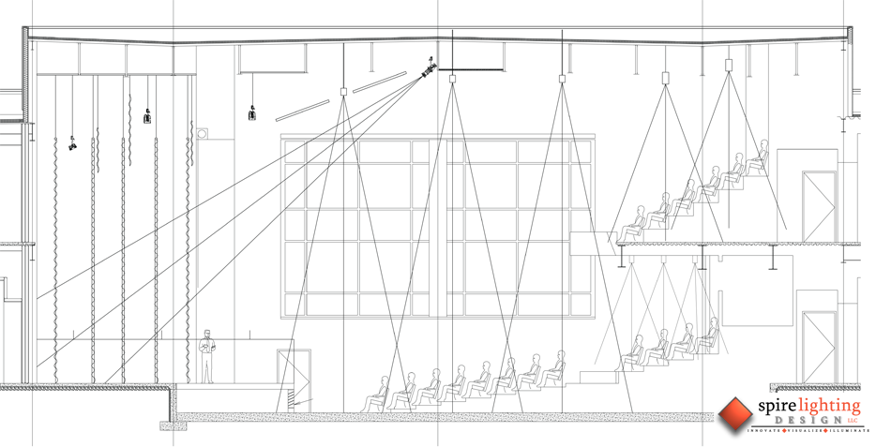
Drawings show location of lamp as well as the pool/beam of light emitting from it.

Slide 31
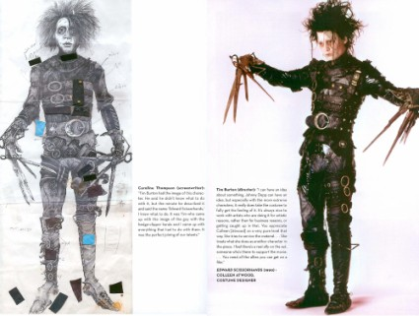
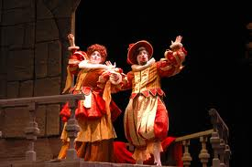
COSTUME DESIGN
The creation and fabrication of clothing and accessories for the overall appearance of a character or performer.

Slide 32
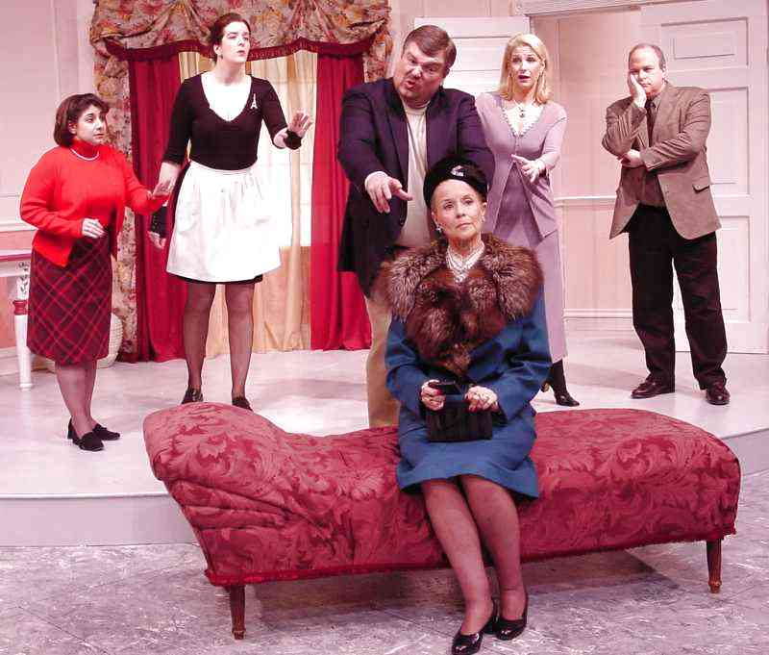
COSTUME DESIGN
Functions of Design:
Show time and place
Establish an environment
Reflect character’s gender, age, personality, occupation, style, social and economic status

Slide 33
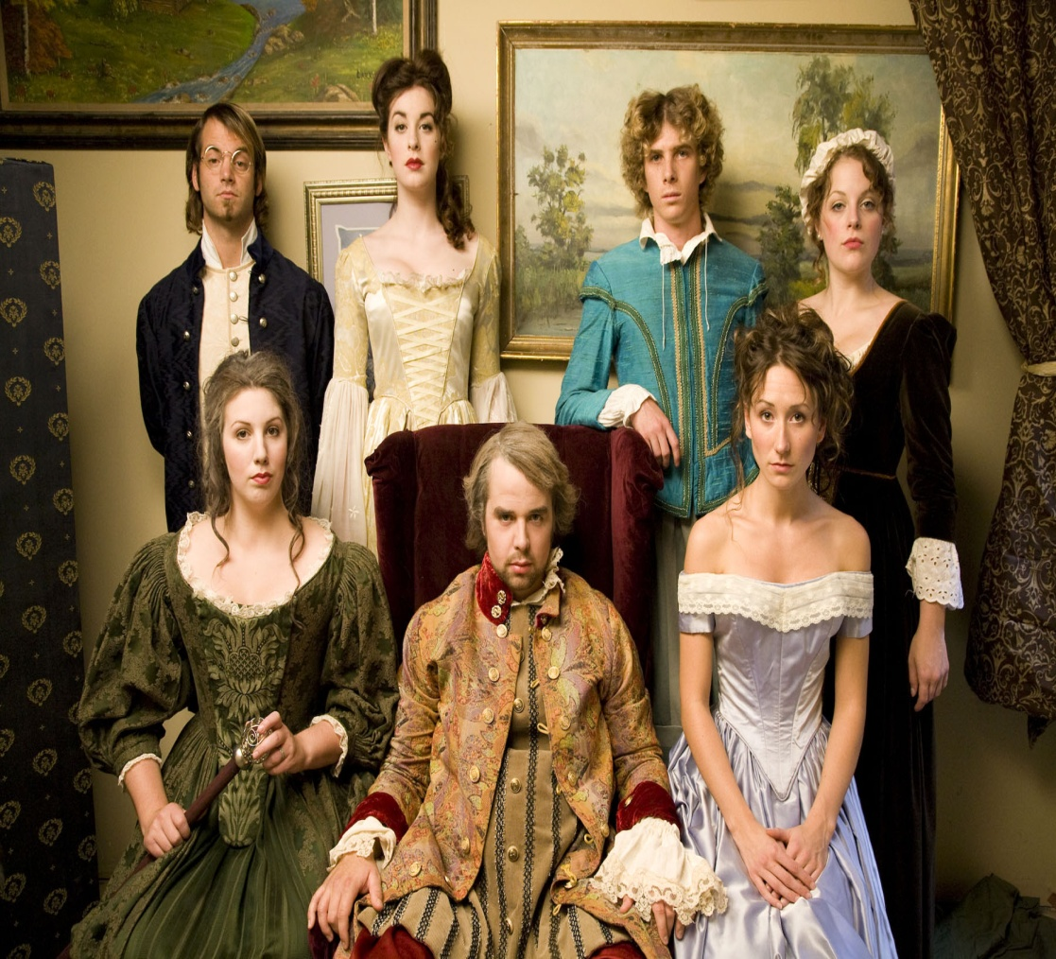
COSTUME DESIGN
Functions of Design:
Reinforce metaphor, symbol or allegorical concept
Establish Mood and atmosphere
Create both variety and unity
Establish or clarify character relationships

Slide 34
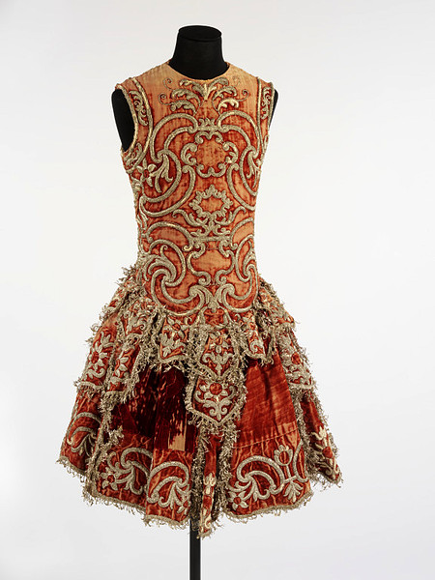
Costume Designer
Costume designers create the look of each character by designing clothes and accessories the actors will wear in performance.
Depending on their style and complexity, costumes may be made, bought, revamped out of existing stock or rented. Their designs need to faithfully reflect the personalities of the characters in the script.

Slide 35
COSTUMES SHOULD BE CAREFULLY PLANNED…
Study the period of when the story takes place
Research in costume books
Look in encyclopedias
Research Old magazines (people or national geographic)
Look at Paintings

Slide 36
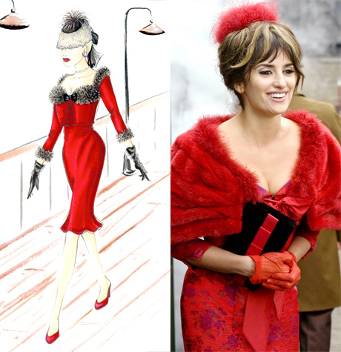
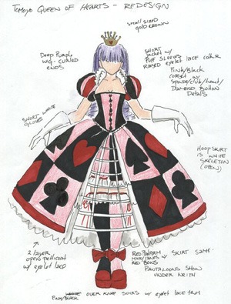
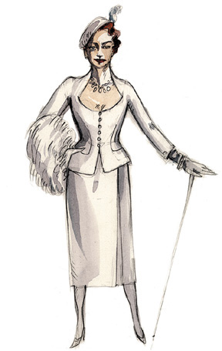
Costume Sketches
Costume designers create several types of drawings
Preliminary sketches
Costume layout
Final costume sketch or rendering

Slide 37
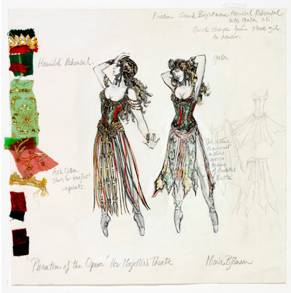
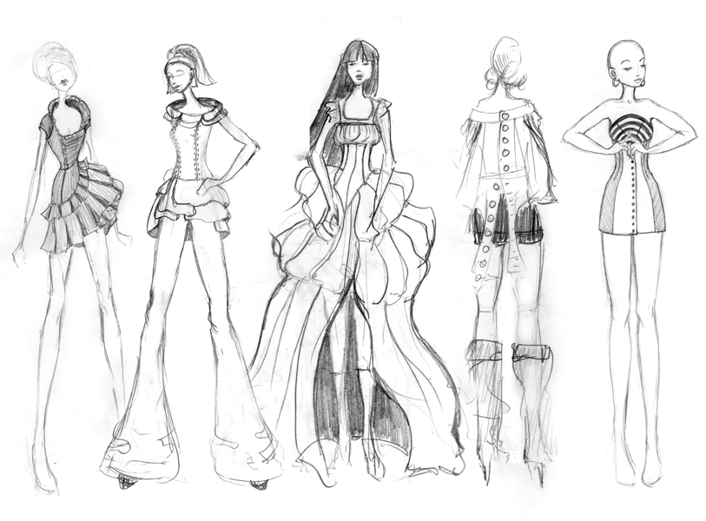
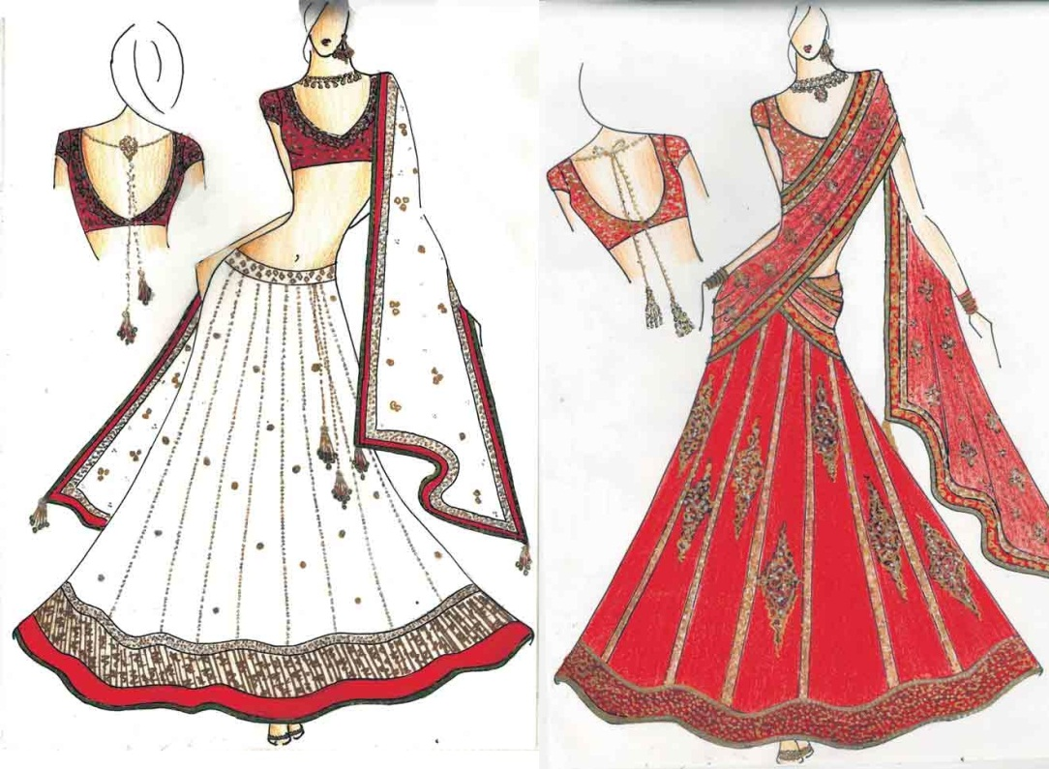

Slide 38
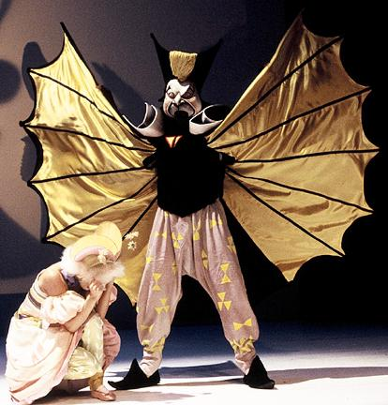
Elements of Costume Design
Related elements
Makeup
Hairstyles
Masks

Slide 39
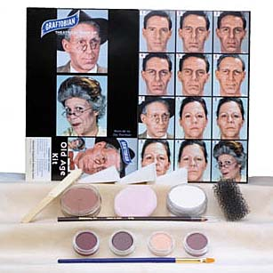
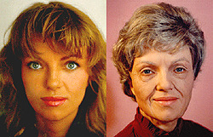
Hair and Makeup
Theatrical makeup refers to makeup that is used to assist in creating the appearance of the characters that actors portray during a theater production.
Needs to be over exaggerated to be seen by the audience
Needs to suit the character, setting and storyline
Use darks to recess (sink back) space, and lights to highlight and bring forward
Address all parts of the face including eyes, brows, lashes, lids, lips, cheeks, ears, neck, hair etc.
Hair can be real or false (wigs/extensions)

Slide 40
Fantasy Makeup

Slide 42
Prosthetic Makeup

Slide 45
Sketches/Drawings

Slide 46
Include rendering and notes clarifying details about all aspects of hair and makeup
Ideally, photos/images and swatches are provided as well

