Slide 1
Composition Rules

Slide 2
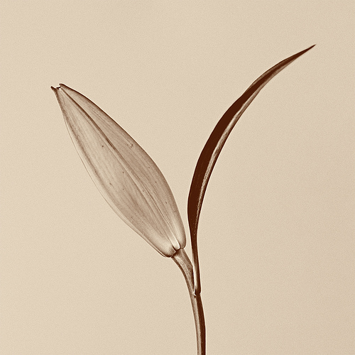
Fill the Frame
Give your subject prominence. Choosing more negative space is ok, but distancing the subject too much causes a boring and unfocussed composition
decide how important your subject is and then give him/her a ratio of the frame that is directly related to his/her importance.

Slide 3
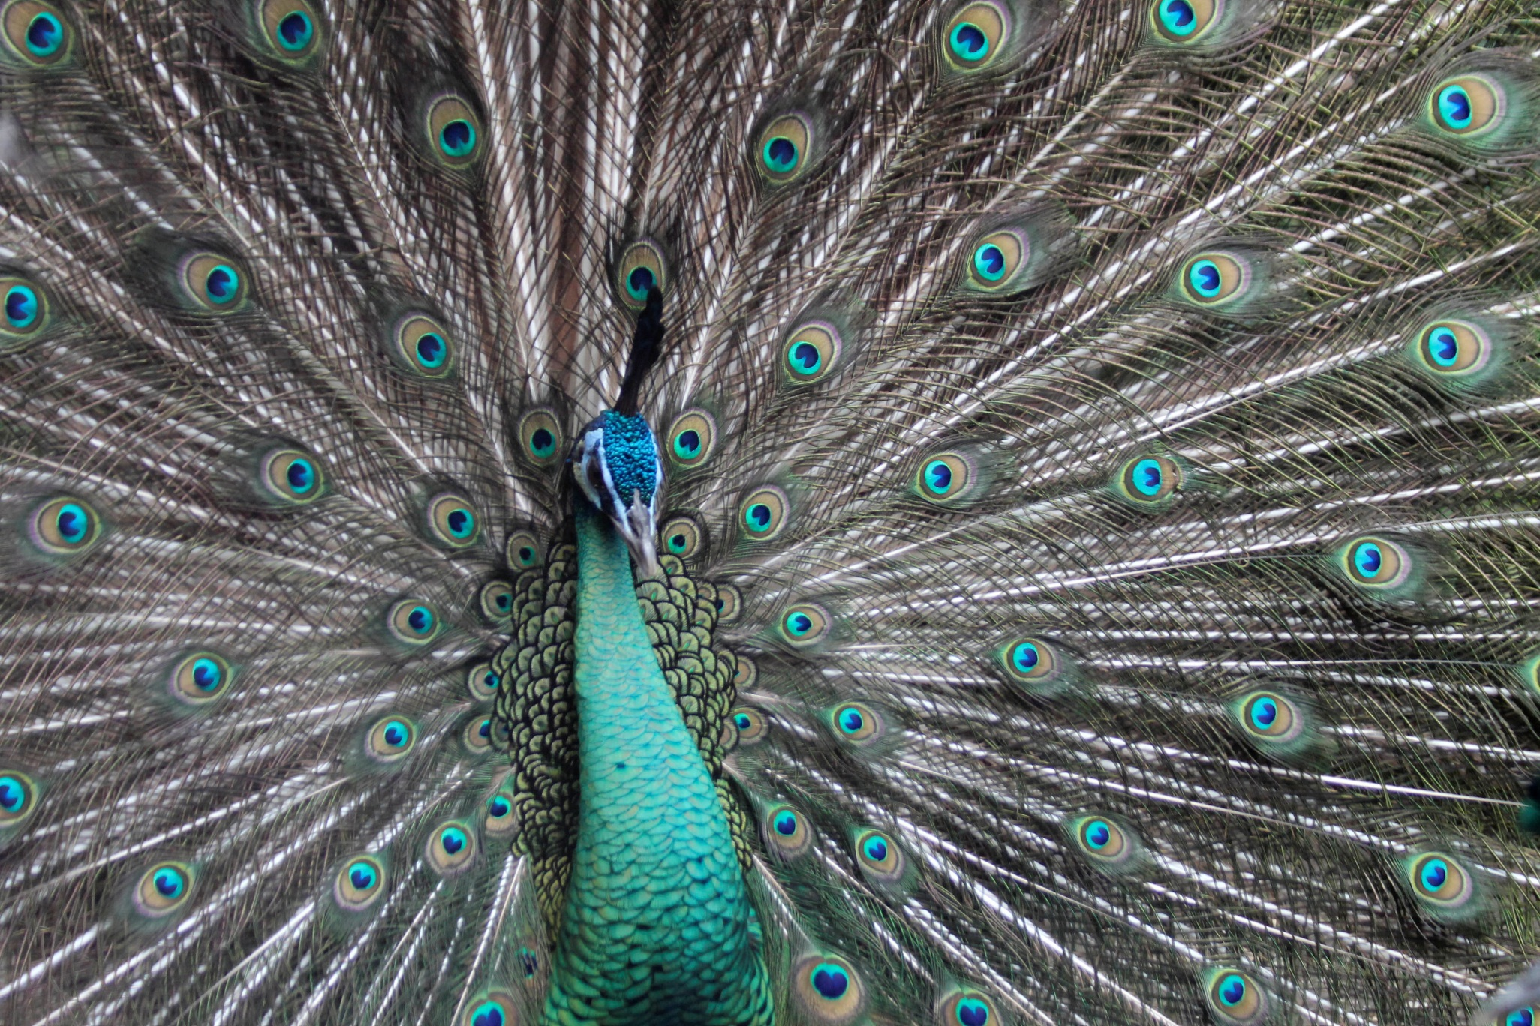

Slide 4
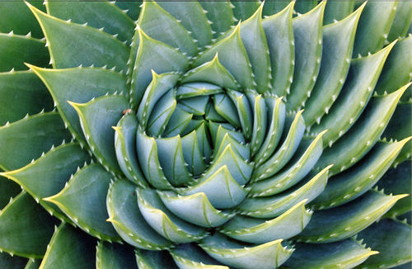

Slide 5
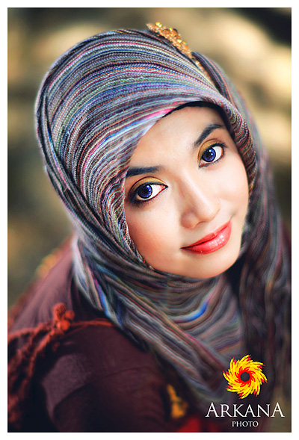

Slide 6
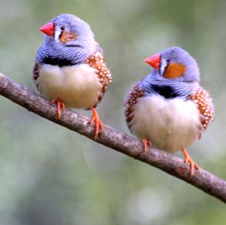
Rule of Odds
The eye tends to be more comfortable with images that contain an odd number of elements rather than an even number.
The human eye will naturally wander towards the center of a group. If there’s empty space there, then that’s where the eye will fall. You want your viewer to look at a subject, not at an empty space.

Slide 7
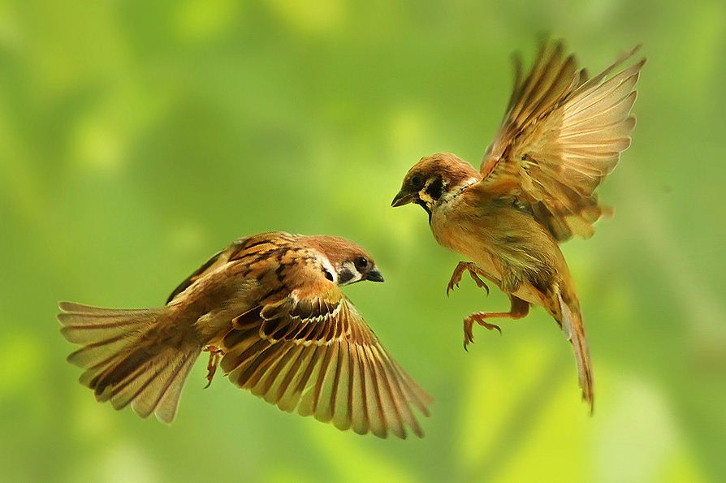
Breaking this rule can create tension, interesting and story

Slide 8
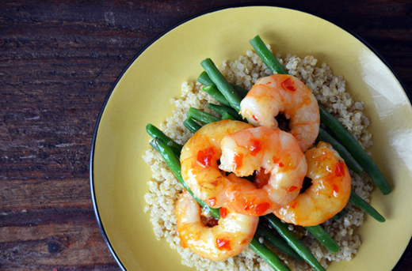

Slide 10
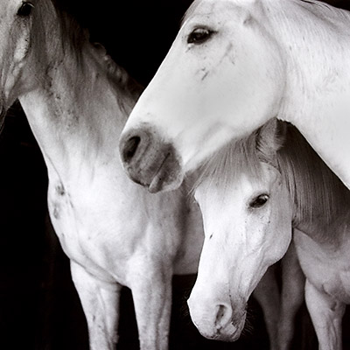

Slide 11
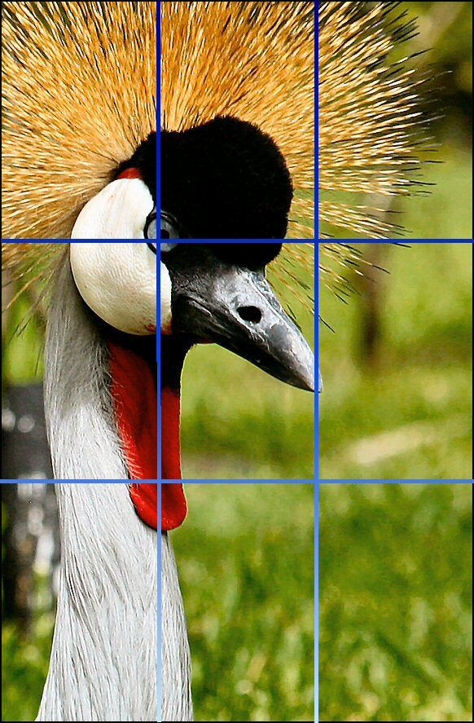
Rule of Thirds
use your eye to roughly divide your image with four lines into nine equal-sized parts, then place your subject at the intersection of those lines.

Slide 12
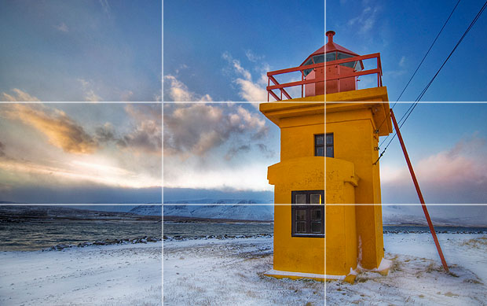

Slide 13
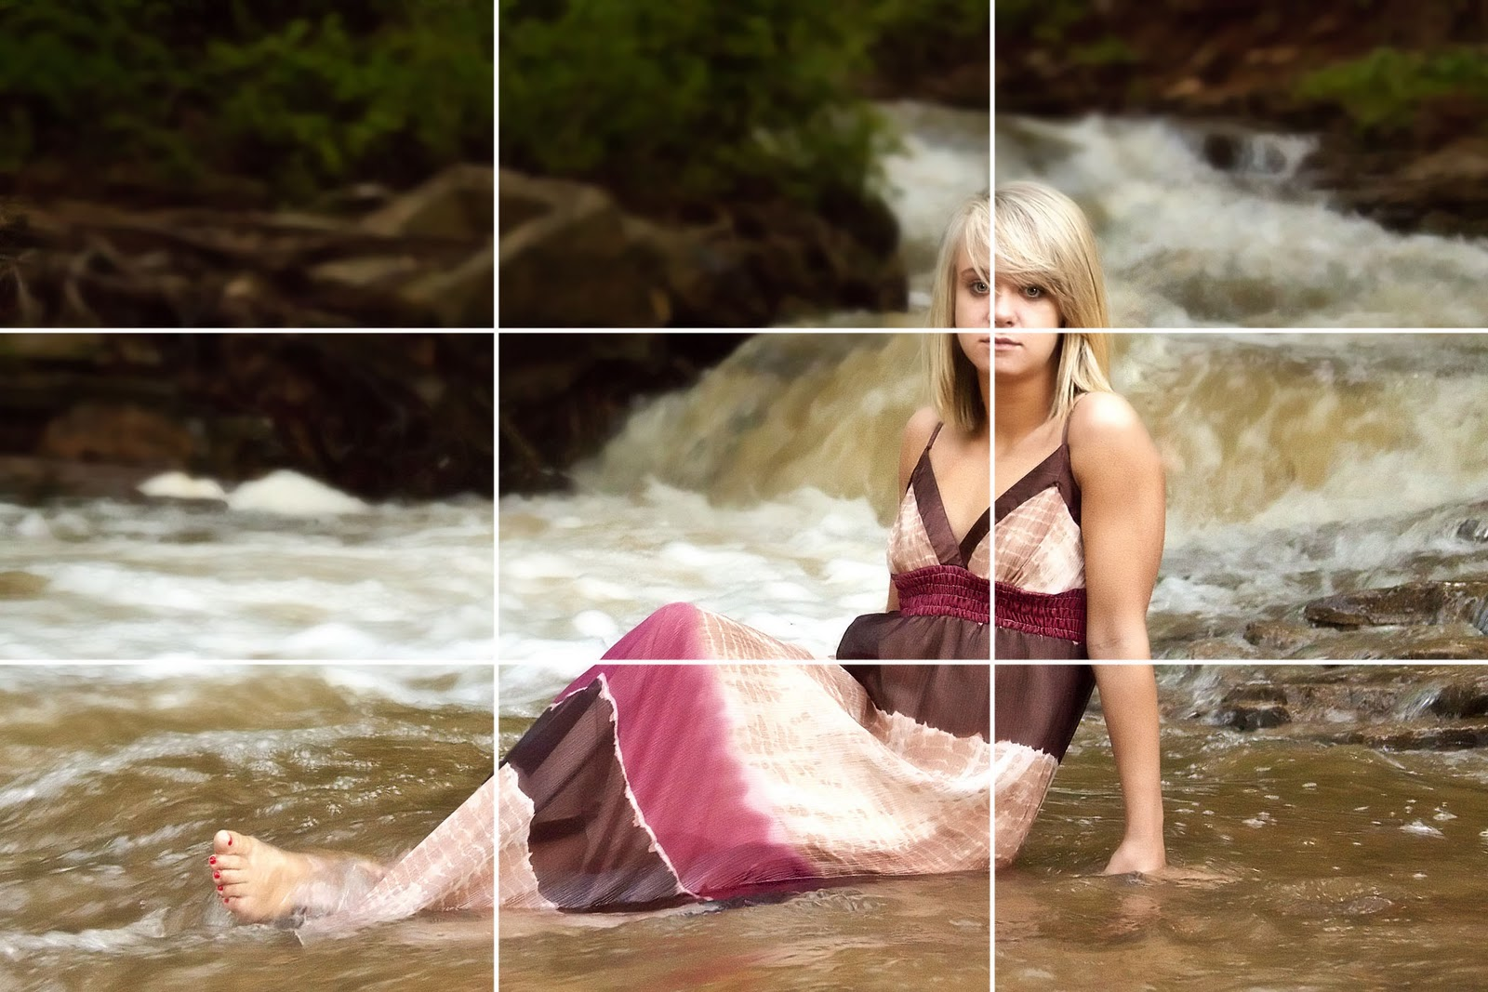

Slide 14
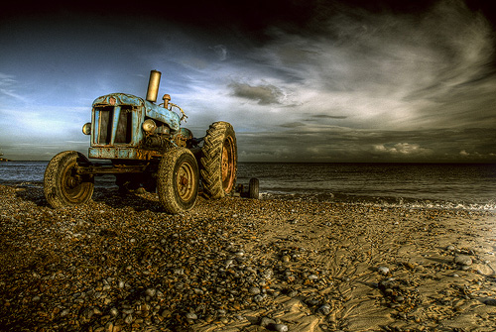

Slide 15
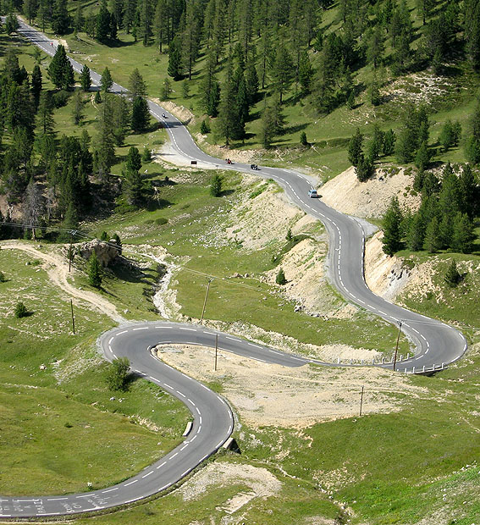
Leading Lines
When we look at a photo our eye is naturally drawn along lines.
By thinking about how you place lines in your composition, you can affect the way we view the image, pulling us into the picture, towards the subject, or on a journey "through" the scene.
There are many different types of line - straight, diagonal, curvy, zigzag, radial etc - and each can be used to enhance our photo's composition.

Slide 17
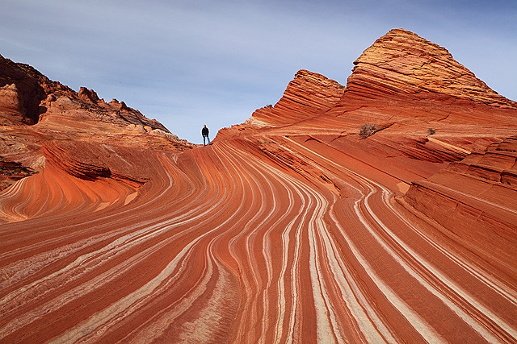

Slide 18
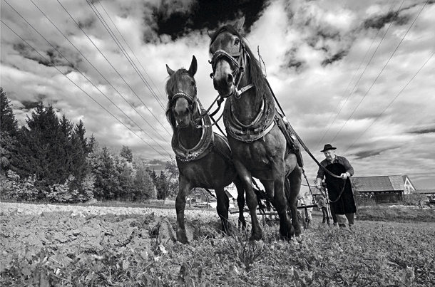
Vary Your Lines
Horizontal lines lend a static, calm feel to a picture, while vertical ones often suggest permanence and stability. To introduce a feeling of drama, movement or uncertainty, look for diagonal lines instead.

Slide 19
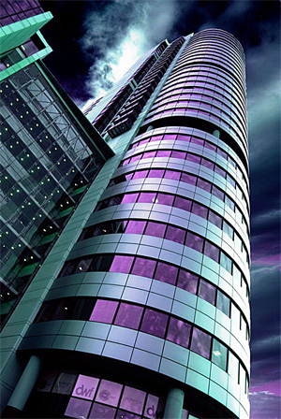

Slide 20
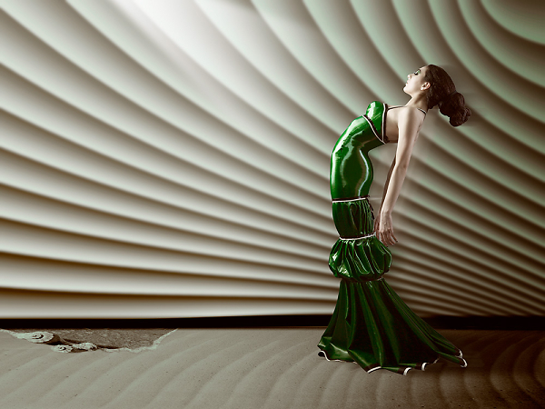

Slide 22
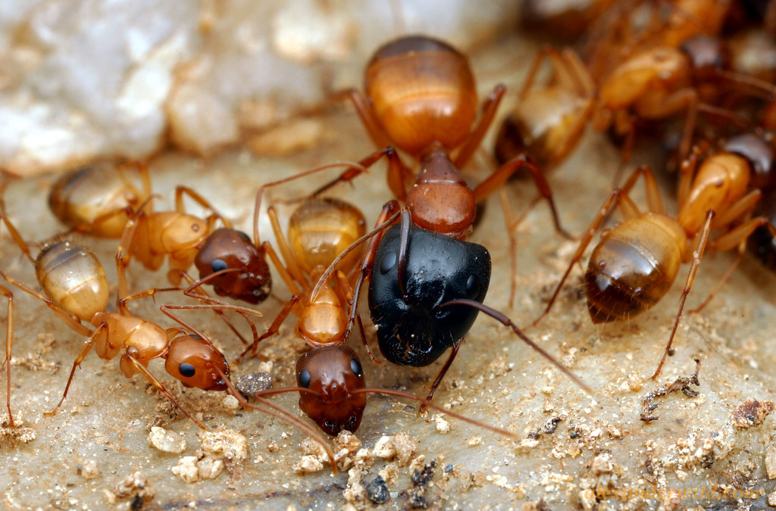
Vary Your Sizes
Varying the size of objects adds interest and strategic focus

Slide 23
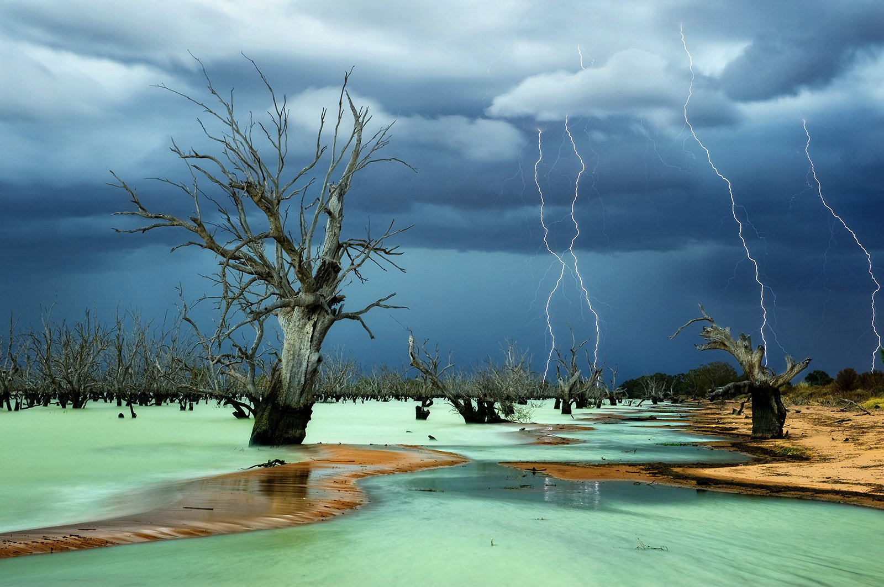

Slide 24
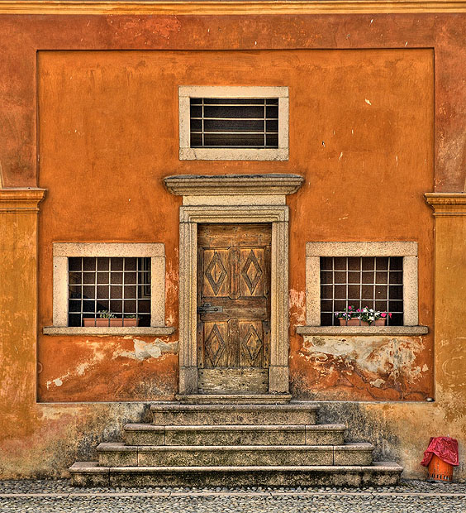
Symmetry and Pattern
break the symmetry or pattern in some way, introducing tension and a focal point to the scene.

Slide 25
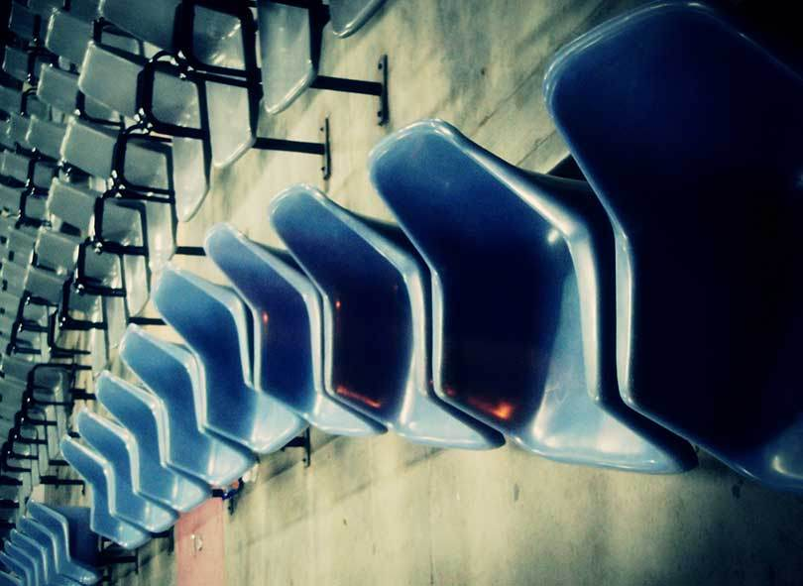

Slide 26
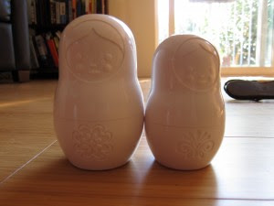
Mergers
1. Object to Object
space objects apart OR overlap them
never have objects awkwardly touching edge to edge

Slide 27
2. Object to Frame
- Never have an object touching the frame. Either overlap it (crop) or allow space between it and the edge

Slide 28
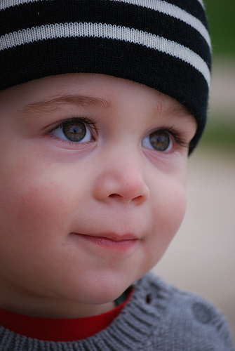
Crop to focus in on a subject, but leave space where required.
Here space is needed to imply where the subject is looking

Slide 29
Aspect Ratio
The aspect ratio of a geometric shape is the ratio between its sizes in different dimensions. For example, the aspect ratio of a rectangle is the ratio of its longer side to its shorter side - the ratio of width to height, when the rectangle is oriented as a "landscape".
So, change the aspect ratio of you photos – don’t always take them the same way (horizontal vs vertical)

Slide 30
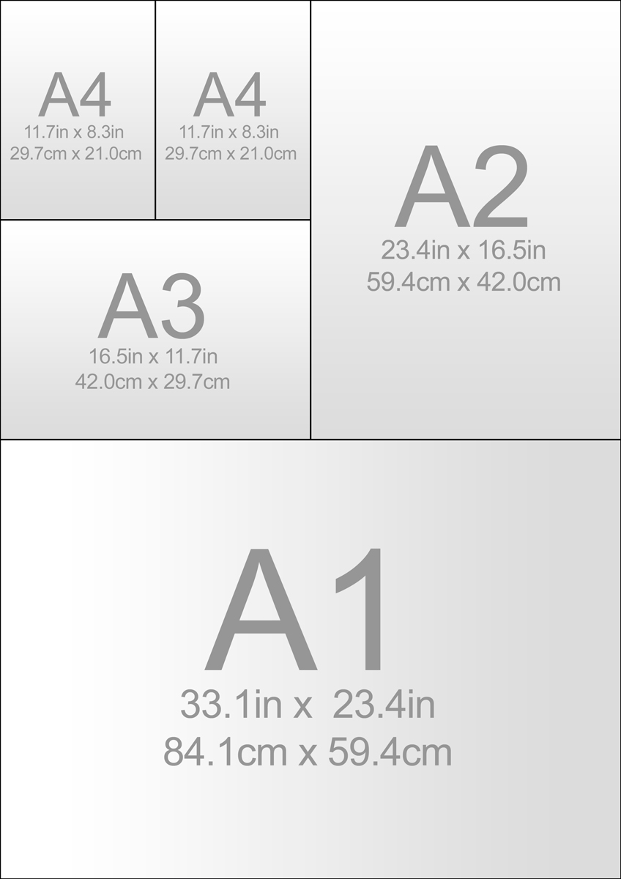

Slide 31
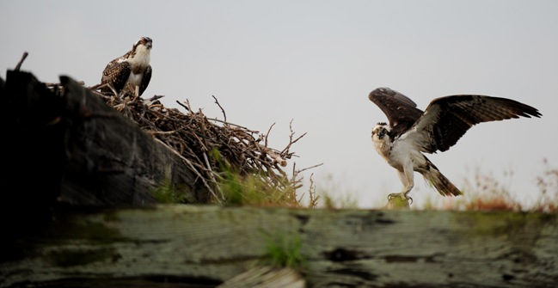

Slide 32
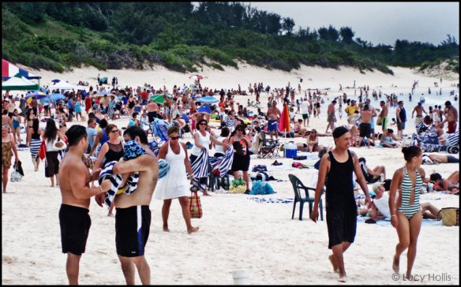
Simplification
look for distracting background elements and cropping them out whenever you can.
Ask yourself: does this element add to my compostion?

Slide 33
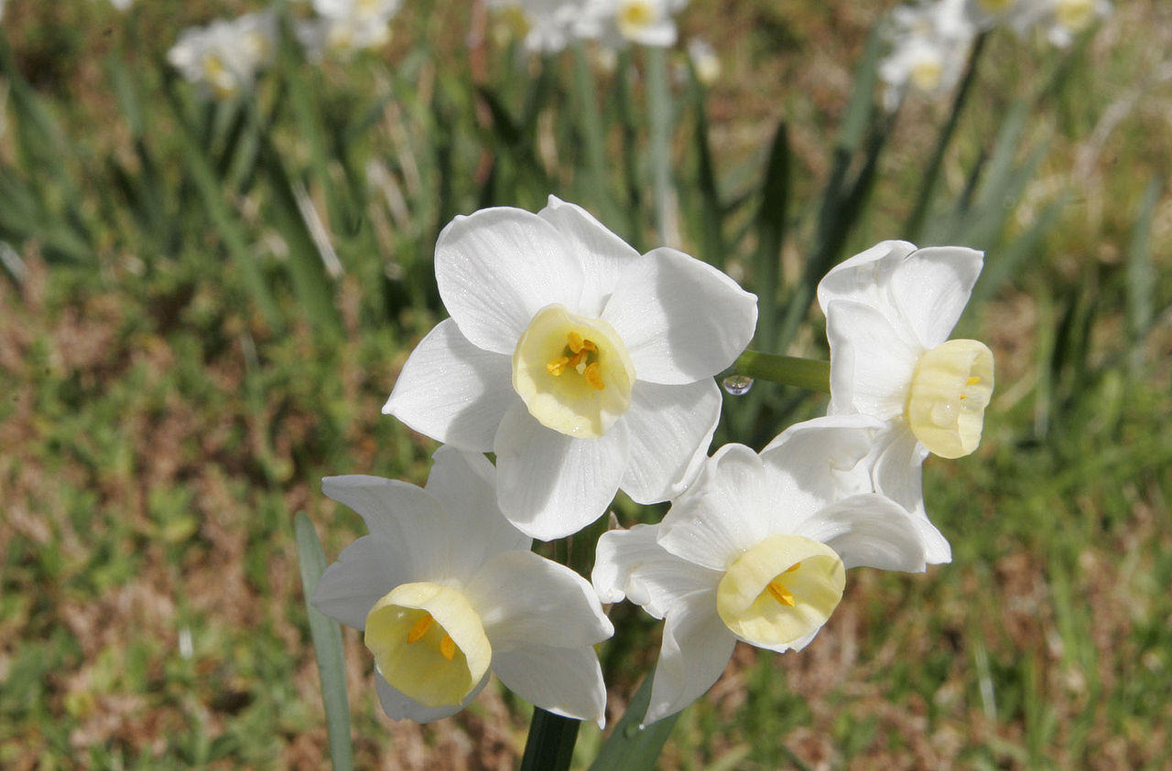
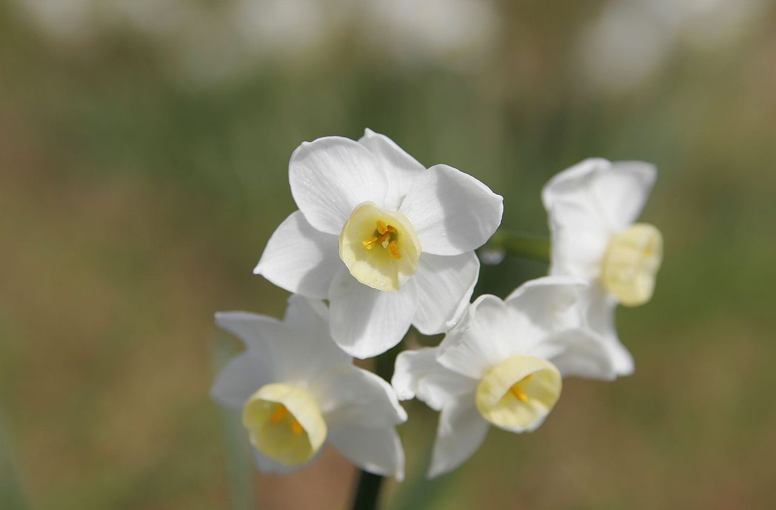

Slide 34
