Slide 1
CLAY terms and techniques

Slide 2
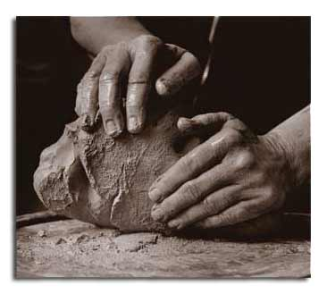
RAW CLAY
a stiff, sticky fine-grained earth, typically yellow, red, or bluish-gray in color and often forming an impermeable layer in the soil.
It can be molded when wet, and is dried and baked to make bricks, pottery, and ceramics

Slide 3
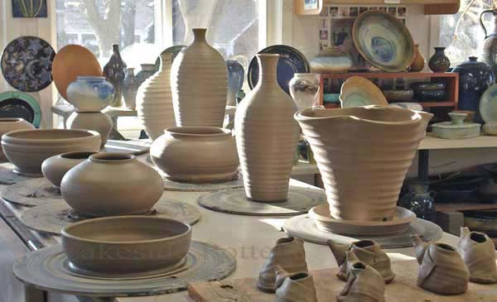
POTTERY
pots, dishes, and other articles made of earthenware or baked clay.

Slide 4
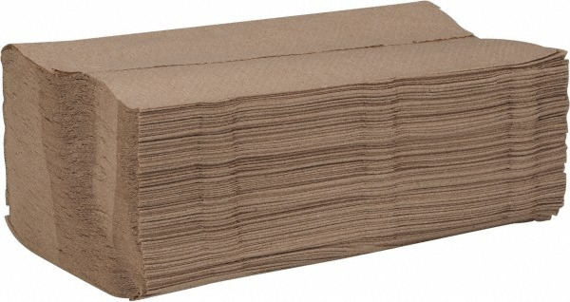
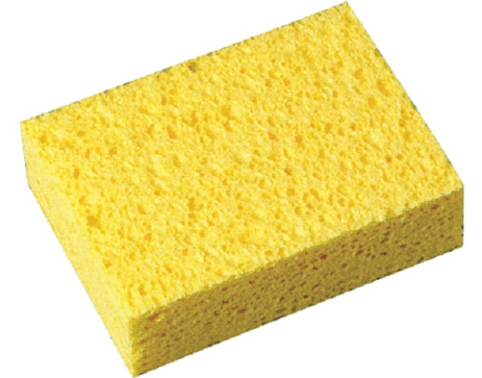
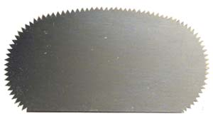
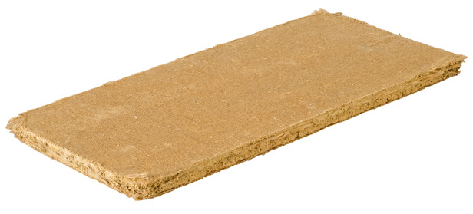
TOOLS
plastic
scraper
Paper towels
sponge
board

Slide 5
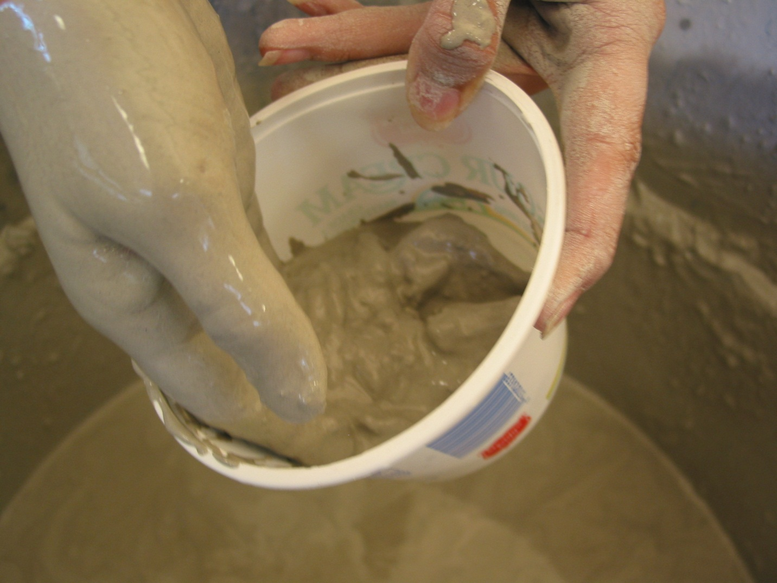
SLIP
Bits of dried clay mixed with water to create the “glue” to stick slabs or coils together

Slide 6
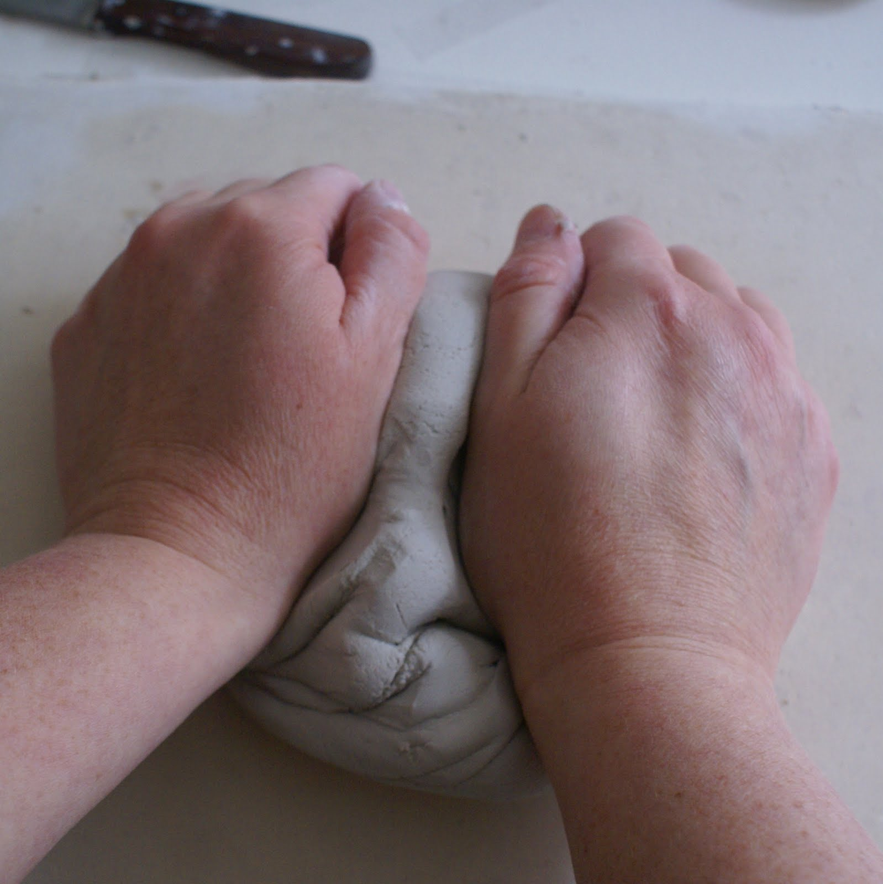
KNEADING/WEDGING
Working your clay by folding, turning and compressing
Smooths clay and eliminates air bubbles

Slide 7
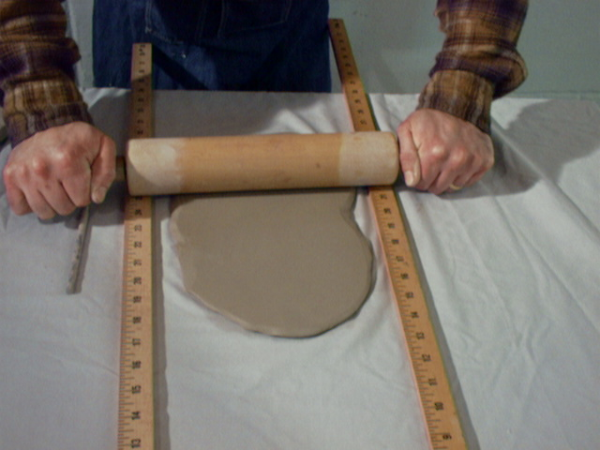
Rolling
Using a rolling pin, and levelers, roll out slabs of clay
Used to create slabs

Slide 8
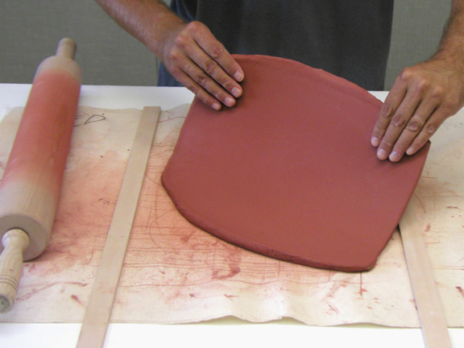
SLAB
A uniformly flat section of clay that has been rolled
Used to create your base or a large section of surface

Slide 9
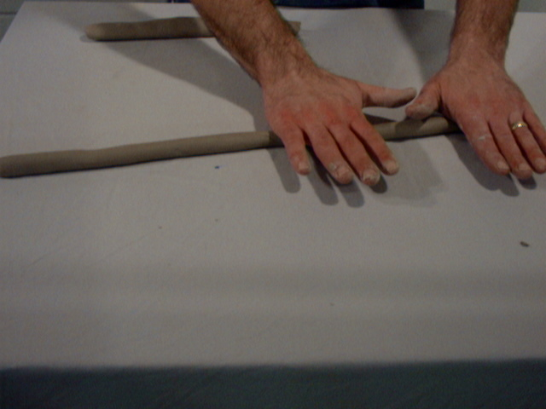
COIL
Rolling out a “snake” of clay
Used to stack and build stable walls on a vessel or pot

Slide 10
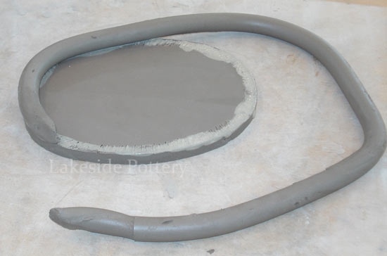
COILING METHOD
Score and slip between your base slab and each coil

Slide 11
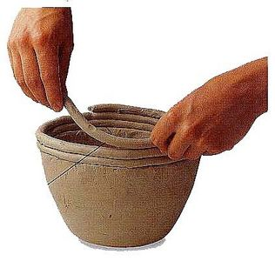
Coils are layered upon each other to build up the body of your vessel.
Coils build more strength vs a slab

Slide 12
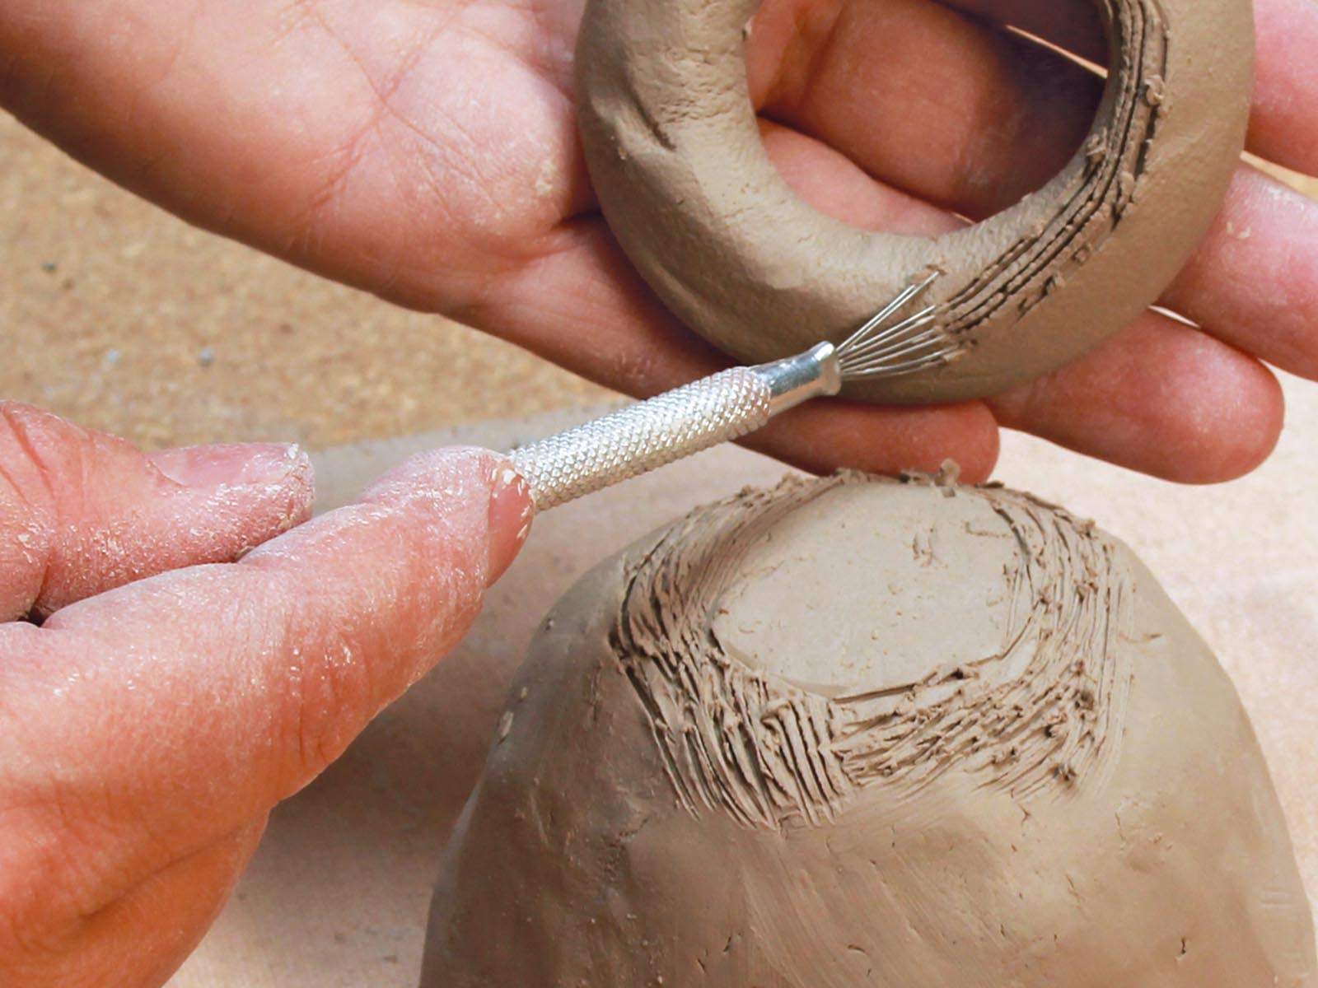
SCORE
Crosshatching lines into your clay to create vessels where the slip will sit to “glue” pieces of clay together

Slide 13
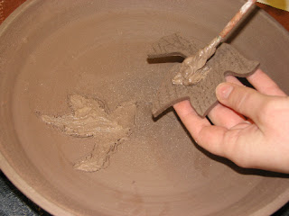
SCORE AND SLIP
Score and slip both sides of the surface to glue them together

Slide 14
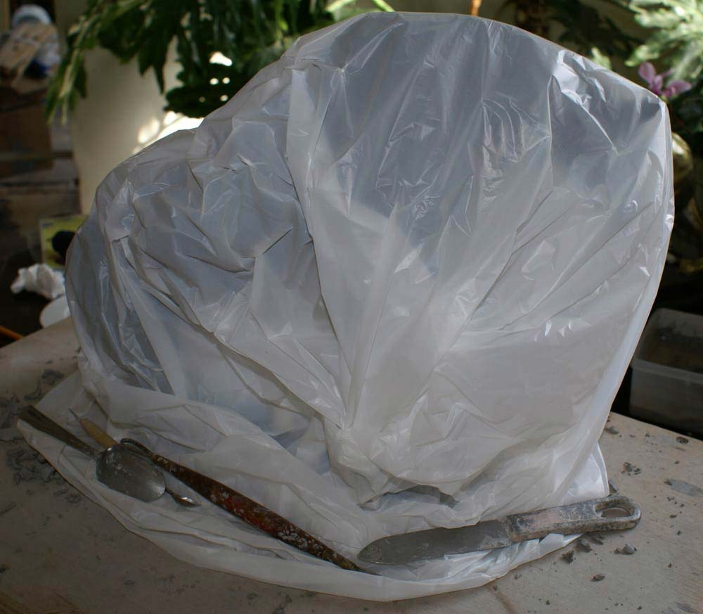
DAMPEN
Wrap your clay in damp paper towels and plastic between work sessions to keep it usable

Slide 15
DRY
When completely finished, leave your piece out in the air to dry out
Ensure the piece is thoroughly dried for several days

Slide 16
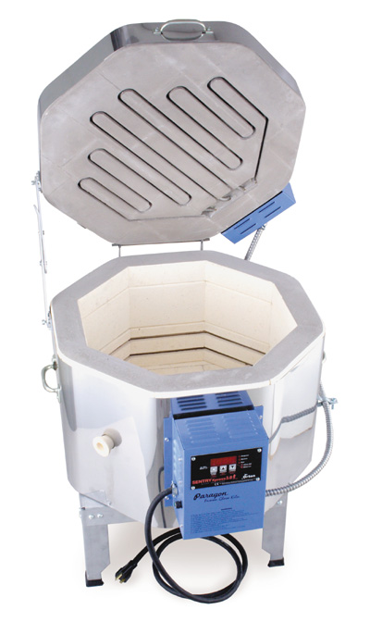
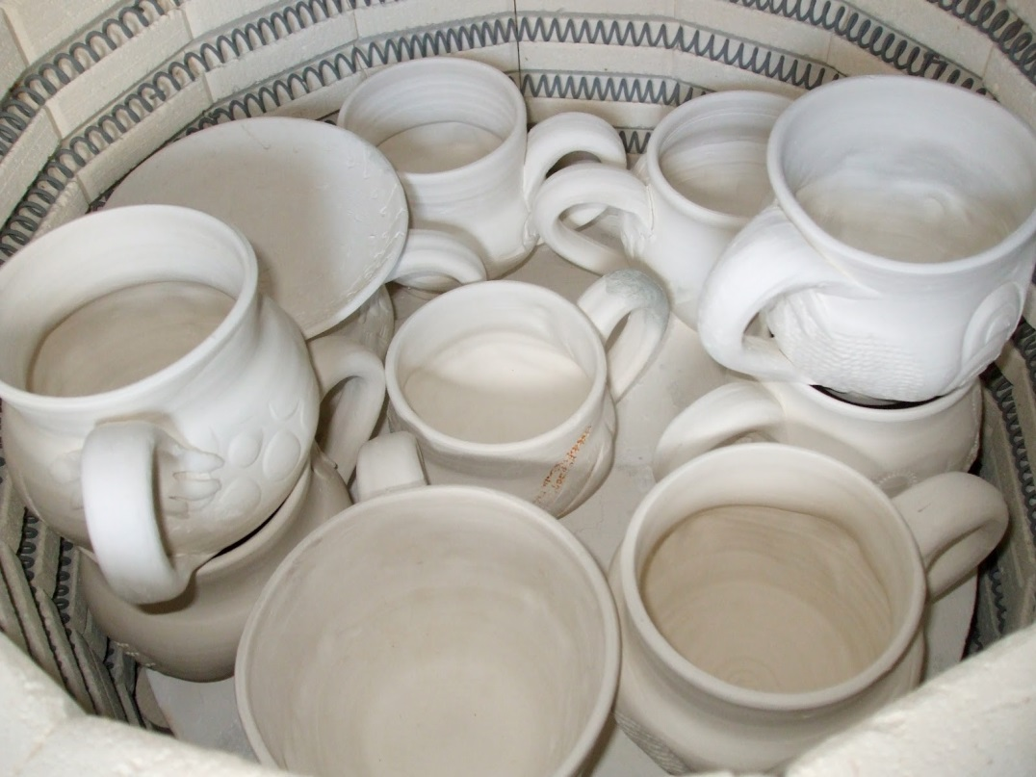
KILN FIRE
Baking off your clay in the kiln to harden it

Slide 17
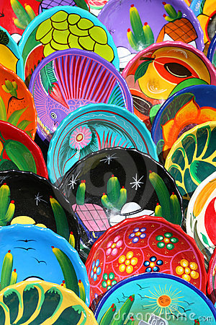
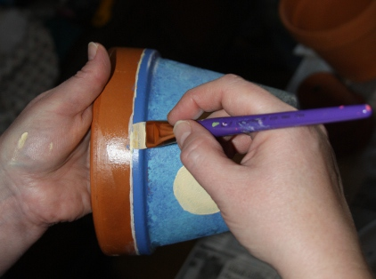
PAINT
You can paint the surface of your baked clay for decoration

Slide 18
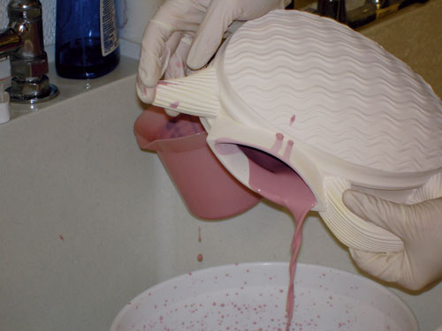
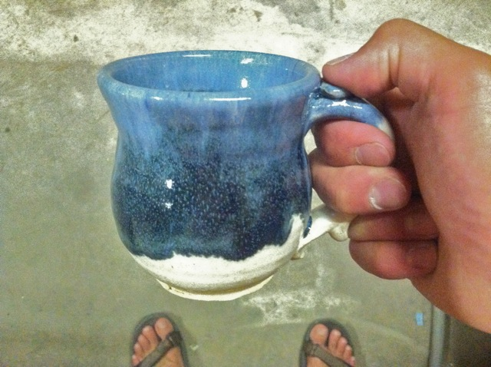
GLAZE
Glaze is a layer or coating of a vitreous (glass/paint) substance which has been fused to a ceramic object through firing. Glaze can serve to color, decorate, strengthen or waterproof an item.

Slide 19
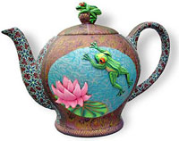
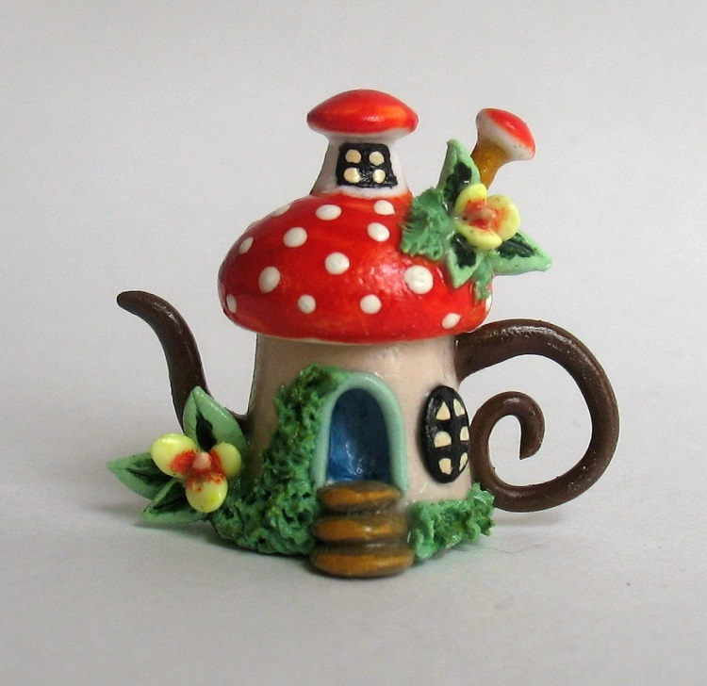
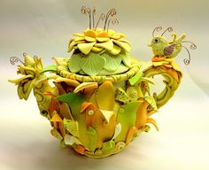
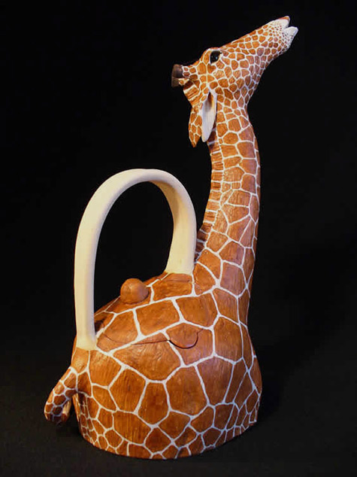
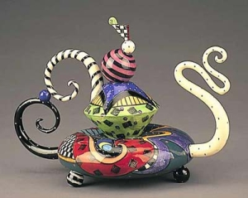

Slide 20
