Slide 1
Shot Perspectives

Slide 2
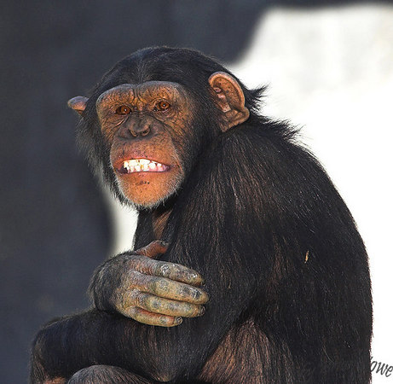
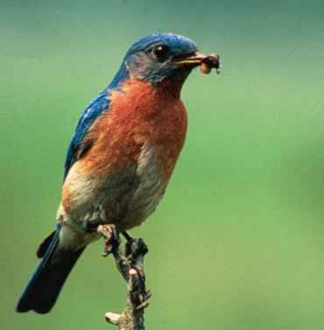
EYE LEVEL SHOTS –
-Audiences sees the event as if in the scene.
-Clearest view of an object.
-Treating characters as equals – achieves empathy.

Slide 3
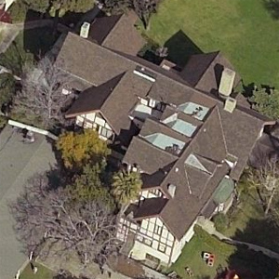
BIRDS EYE VIEW
-From directly overhead
-Idea of fate.

Slide 4
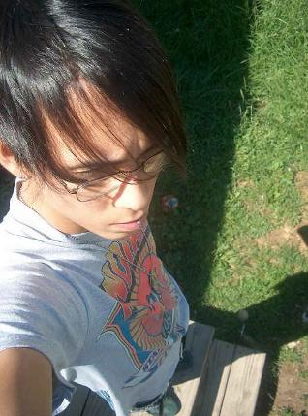
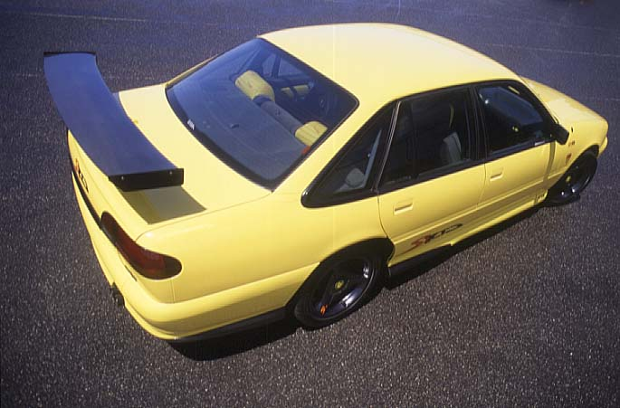
HIGH ANGLED SHOTS
-Camera is tilted downward.
- Person seems harmless and insignificant
-being controlled from outside source, fate

Slide 5
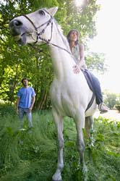
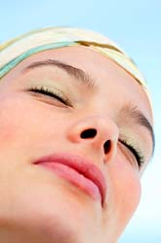
LOW ANGLED SHOTS
-Camera titled upward
-inspires awe
-Environment usually minimized; sky or ceiling is background
-Heightens the importance of a subject

Slide 6
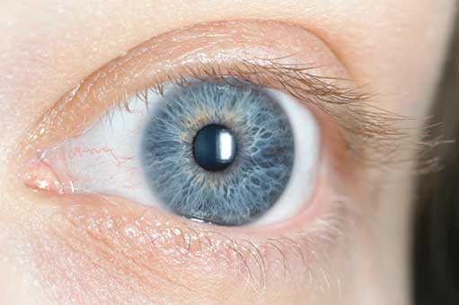
OBLIQUE ANGLE –
-Lateral tilt of the camera.
-Suggests tensions, transitions, impending movement
Image that slants to the right – Acting forceful
Image that slants to the left – Weak, static

Slide 7
Character Perspective Shots

Slide 8
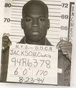
FULL FRONTAL
-Most intimate, vulnerabilities exposed
-Relationship between actor and audience

Slide 9
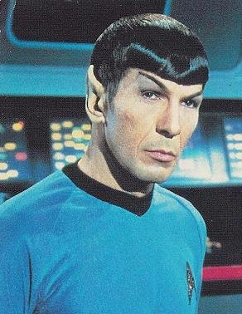
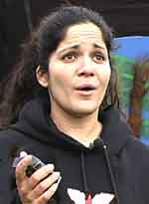
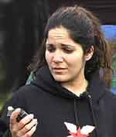
QUARTER TURN – high degree of intimacy but with less emotional involvement

Slide 10
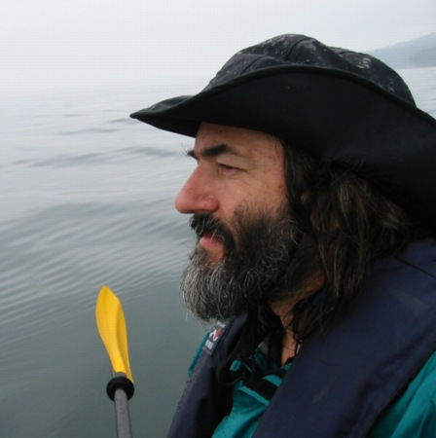
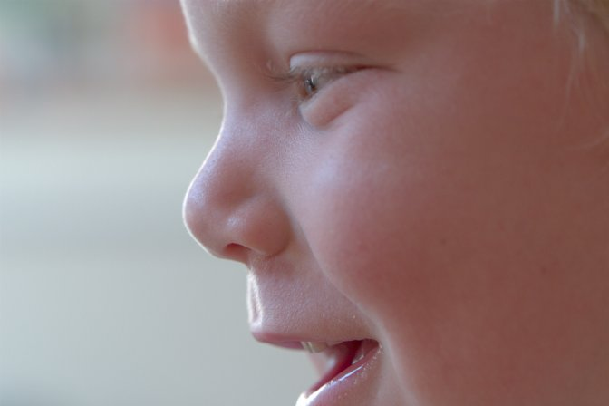
PROFILE – More remote
-Character lost in their own thoughts.

Slide 11
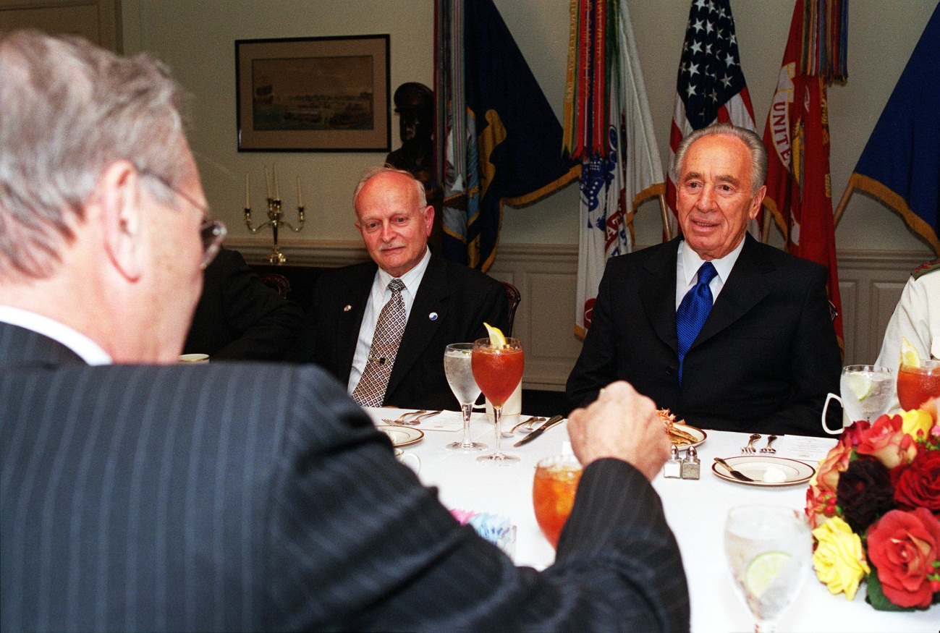
THREE QUARTER TURN – More anonymous.
Rejecting audiences

Slide 12
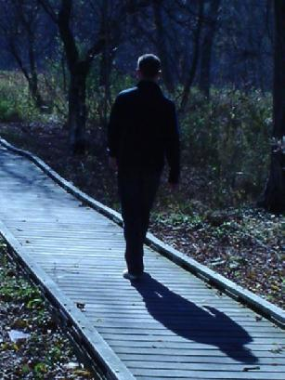
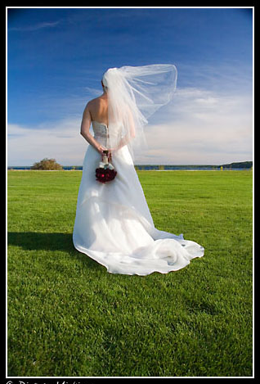
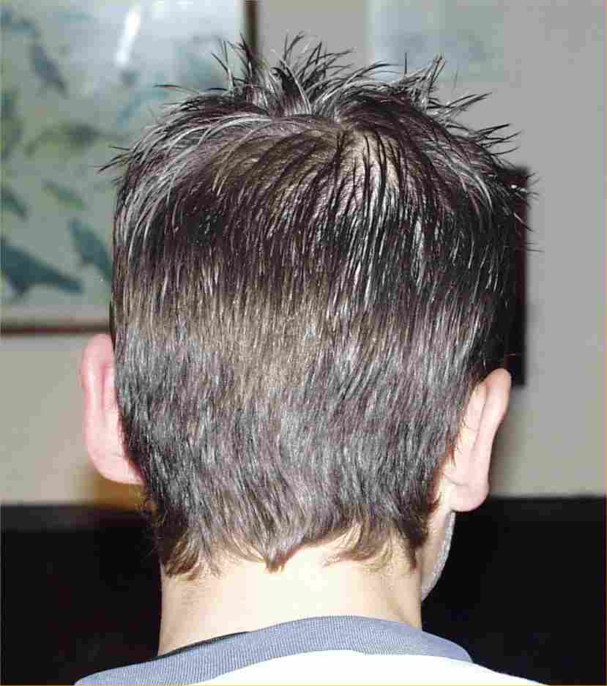
BACK TO CAMERA
-Characters alienation from the world.
-Sense of concealment, mystery.

