Slide 1
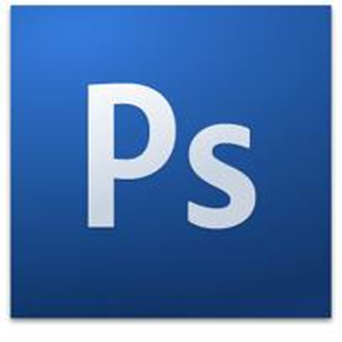
Photoshop Basics
Learning the Basics and Understanding how to work through Adobe Photoshop
ALC1OIPY

Slide 2
What is Photoshop?
Image editing program
Shows images as bitmaps
Bitmap = arrangement of dots (pixels) on grid
Pixel = “Picture element” - smallest unit of an image
End result/product can be saved in a variety of ways: .psd, .gif, .jpeg, .png, .tif , .bmp
Notes:
.psd - Native Photoshop file, usually needs to be saved as other type; New images, layered images start as .psd
.gif - Good for web, used for simple images, large eras of flat color; Often good for B & W; Supports transparency; Lossless
.jpeg - Good for web, used for photos or complex coloration (e.g. – gradients); Slightly longer to download (decompression time); Lossy; Doesn’t support transparency
.png - Good for web, best of both worlds (lossless, supports complex photographs); Not supported by older browsers
.tif - Good for print media; Can be imported by most apps (QuarkX, Pagemaker, InDesign); Large file sizes (but compressible); Can supports layers
.bmp - Simple grid of pixels; Uncompressed, large file sizes; Can be imported by almost all apps

Slide 3
Understanding Images
An image is made up of dots called pixels
In Photoshop, you can add, delete, or modify individual pixels or groups of pixels
Size of pixel depends on resolution
  Typical web image: 72 dpi
  Typical print image: 300 dpi or higher

Slide 4
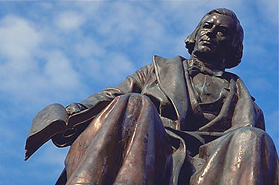
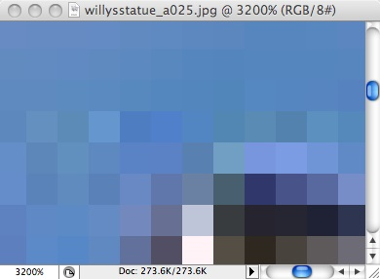
Basic concepts
Pixel
  Specific location
  Specific colour
Magnify an image to see pixels

Slide 5
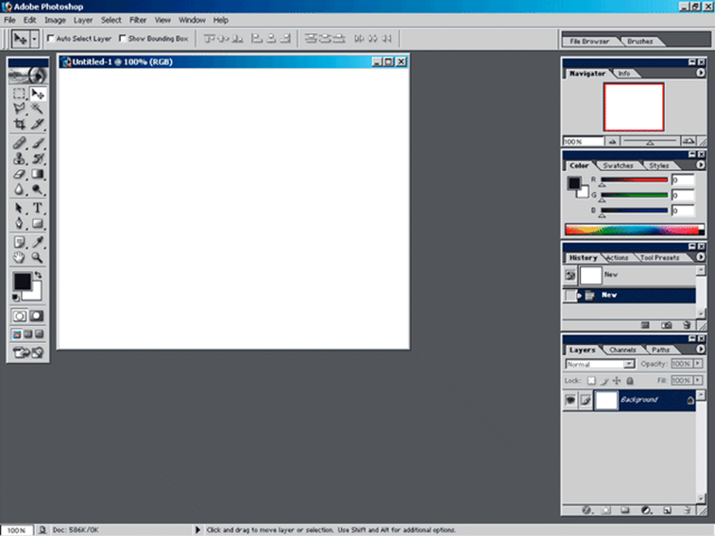
Work Area
The work area is what your screen looks like and has on it while you are working in a program.

Slide 6
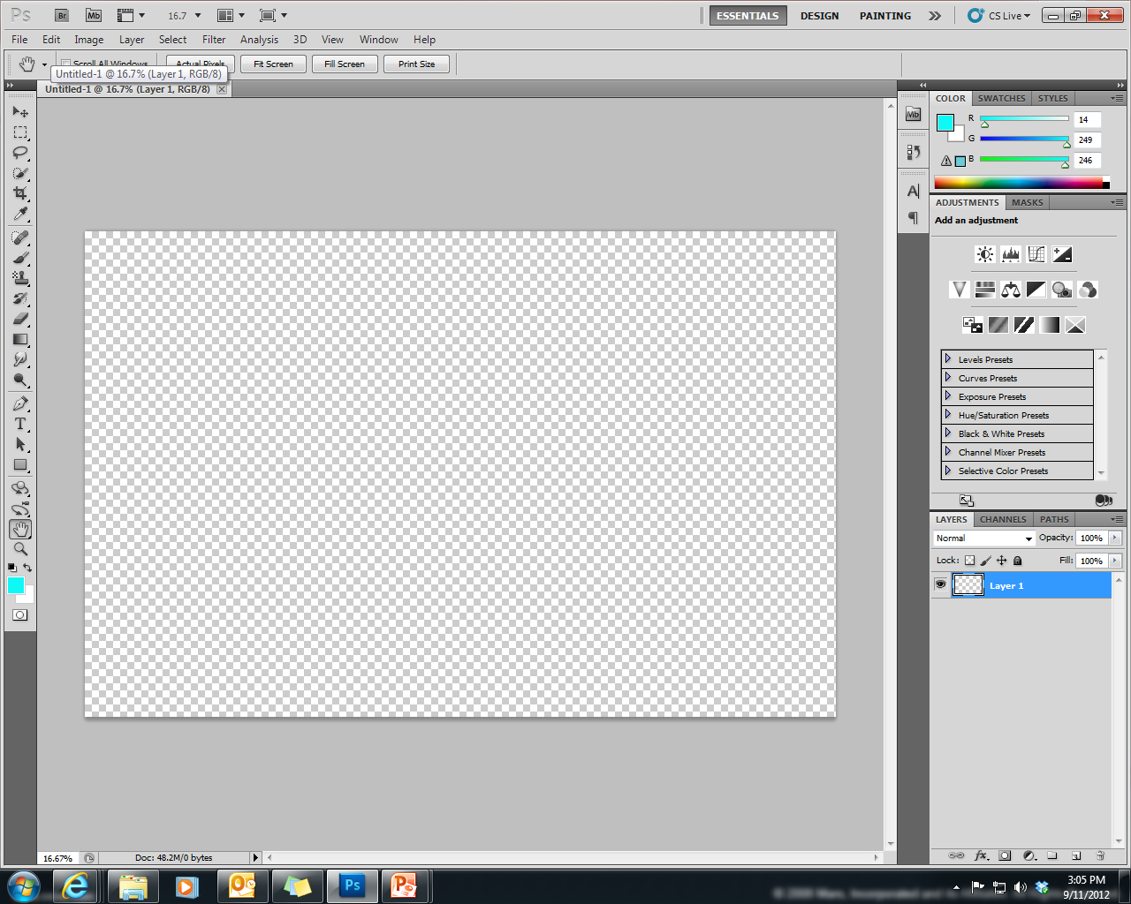
Toolbox
Menu Bar
Options Bar
Document Tab
Document Window
Panels
Zoom Level
Status Bar

Slide 7
Toolbox

Slide 8
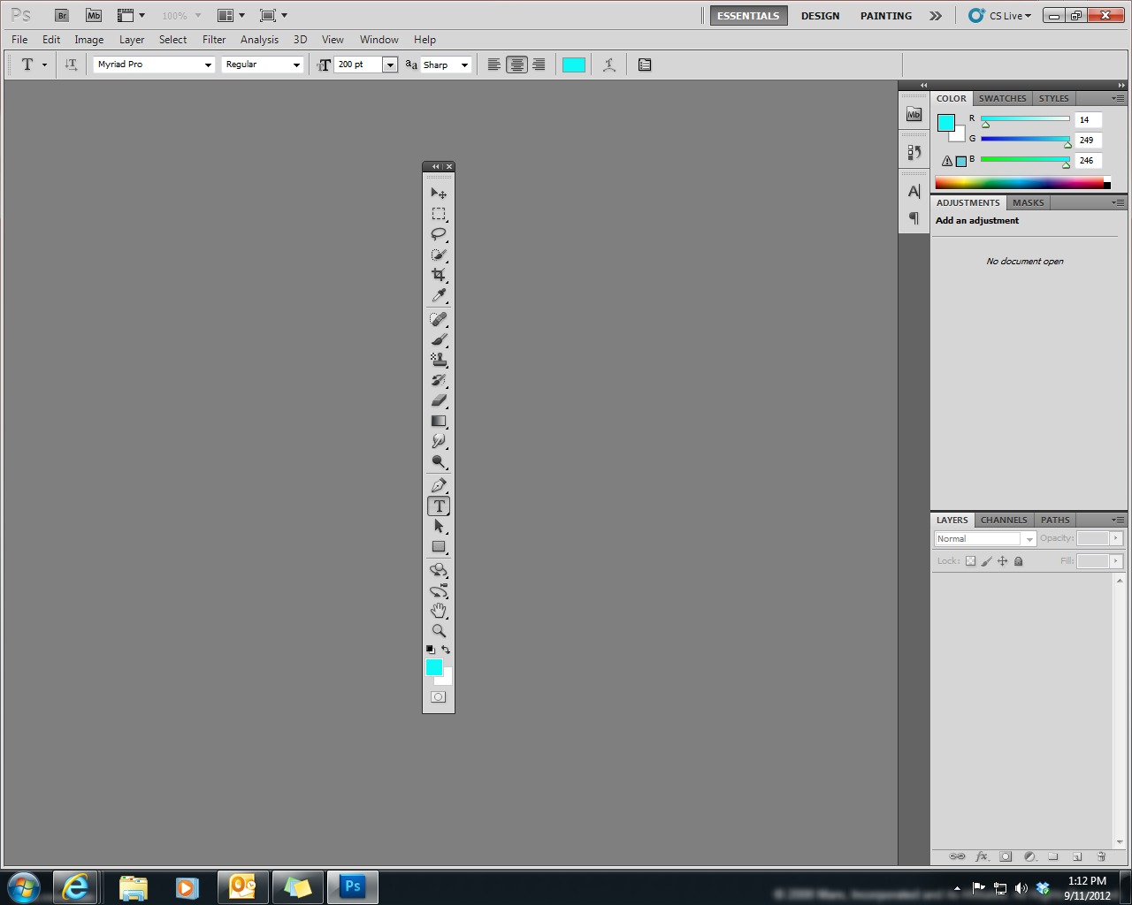
Photoshop Toolbox
*Holds all tools for Photoshop.
*On the left side of your work area.
*Make sure you understand all
tools and know what they are used
for.

Slide 9

The Toolbox
Commonly used tools arranged as icons
Triangle in lower right means multiple tools are nested there
Left-click the icon and hold down the button to see all tools nested there
Paint bucket icon
Expanded: Gradient and paint bucket tools
Notes:
Point out more obvious tools
Have everyone l-click and hold on paintbucket

Slide 10
Selection Tools
*Selection Tool (black arrow)
*Marquee Tool
*Lasso Tool
*Quick Selection Tool
*Magic Wand Tool
*Crop Tool
*Eyedropper Tool
Allow you to choose or select different parts of the image and change them, move them, format them, add something to them, etc.

Slide 11


a. Move Tool: lets you move a selection marquee or objects on a single layer.
b. Marquee: allows you to select rectangular or
elliptical areas in an image.
c. Lasso tools: lets you draw a freehand selection area, with either curves or straight lines.
d. Magic wand: allows you to select all the same-colour or similarly coloured adjacent pixels
e. Crop: allows you to cut the image
f. Eyedropper tool: allows you to sample a colour from an image to use this colour further.

Slide 12
Retouching/Painting Tools
*Spot Healing Tool
*Red Eye Removal
*Brush Tool
*Pencil Tool
*Clone Stamp Tool
*Art History Tool
*Eraser Tool
*Smudge Tool
*Gradient Tool
*Paint Bucket Tool
Allow you to create a better look from your image. Taking out smudges, replacing spots in image, erasing parts of the image, backtracking through the different tasks that you have already done to go back to the original look, etc.

Slide 13

a. Spot Healing Brush: removes blemishes, imperfections, and red eye.
b. Brush: paints brush strokes.
c. Gradient: helps you to paint stage by stage with
more than 2 colours
d. Paint Bucket: fills out a cropped part with just one
click of this tool
e. Eraser: Erases what you cropped or where you
click with your mouse after selecting this tool

Slide 14
f. Smudge: has the same effect as rubbing canvas
with fingers
g. Dodge: Makes bright the part where you
scrub with this tool.
h. Clone Stamp: copies a selected part and restores
it where you want
i. Pattern Stamp: this is nearly the same tool with
clone stamp, but you can arrange the shape you
cropped, and you can use it as a fixed shape

Slide 15
Drawing Tools
*Pen Tool
*Text Tool
*Path Selection Tool
*Shapes Tool
*(Brush, Paint bucket, Gradient Tools
can also be classified as Drawing tools).
Allow you to add things to your image like an object, shape, or text and allow you to draw images from scratch.

Slide 16
Document Viewing Tools
*Hand Tool
*Magnifier Tool
*Rotate Tool
*Background/Foreground Tool
*Quick Mask Mode Tool
Allow you to move things in your document, look closer at the document, change or move the foreground and background, change the mode of the document you are working in.

Slide 17

Set foreground/background colour
- Foreground colour: Photoshop uses the foreground colour to paint, fill, and stroke selections
- Background colour: used to make gradient
(the colour will be different from the
foreground colour).

Slide 18
Menu Bar

Slide 19

The Menu Bar

Slide 20
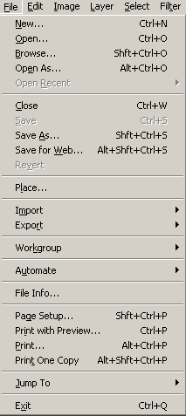
File
a. Save, Save as, Save for web
- Save
- Save as: Save as a new filename
- Save for web: Save a image as a form
of “*.jpg” or “*.gif” which is used for
web image
b. Place, Import, Export
- Place/Import: Bring another image
into the canvas you are working
- Export: Sending the image you are
working to other applications
c. Print

Slide 21
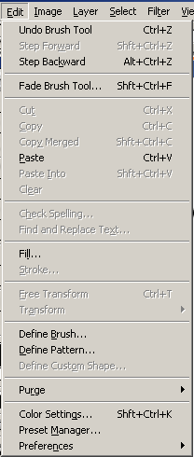
Edit
a. Undo, Step Forward/Backward
- Undo: Cancel the last work
- Step Forward: Move to the next stage
which you did
- Step Backward: Move to the previous
stage which you did
b. Cut, Copy, Paste
- Cut: Get rid of a part which you select
- Copy: Copy a part you select
- Paste: Attach the part you copied

Slide 22
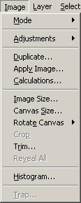
Image
a. Mode: Select a type of color
b. Image size, Canvas size
- Image size: Change the size of the image
- Canvas size: change the size of the canvas
where you are working
(Bottom of your image)
c. Rotate canvas: Changing the direction of
your canvas

Slide 23
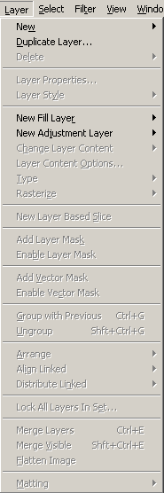
Layer
a. New, Delete
- New: Create a new layer
- Delete: get rid of a layer you selected
b. Arrange
- change the order of layers
c. Merge
- Make layers into one layer

Slide 24
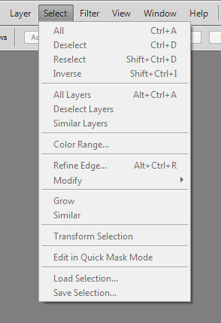
Select
Selects all, deselects, inverse
- all: grabs everything on current
layer
- inverse: flip-flop the selection to
select the part that’s not selected
b. All layers, deselect, similar layers, colour range
-colour range: grabs all areas similar
in colour

Slide 25
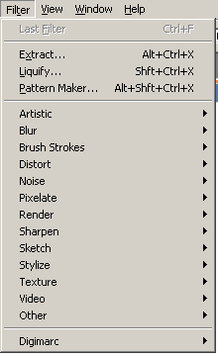
Filter
a. Various Kinds of technical effects

Slide 26
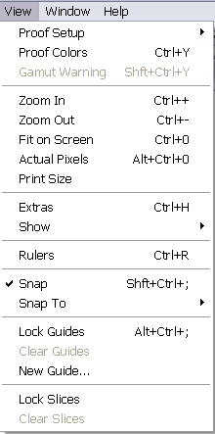
View
a. Zoom in/out
- Zoom in
- Zoom out
b. Print size
- Help you to print only what you need
c. Extras
- Showing horizontal and vertical lines
by dividing into separate sectors

Slide 27
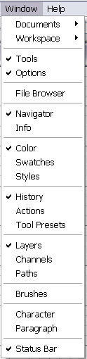
Windows
a. The same function with “view” in other
Windows applications such as MS-Office
b. You can select what you want to make
visible on your page and what you don’t
want to make visible on your page

Slide 28
Panels

Slide 29
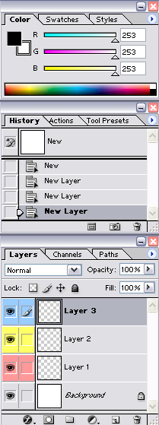
Panels (Palettes)
Colour/Swatches/Styles Panels
History Panel
Adjustments/Masks Panels
Layers Panels
19 panels/palettes available from the Windows menu, only need a few up all the time
Pull up others as needed

Slide 30
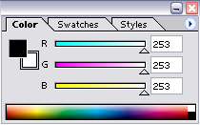
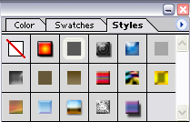
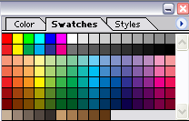
Color/Swatch/Styles Panels
Colour Panel: Mix the colour (basically
RGB colours) and select it for the
foreground and background colours.
In case of another colour type, you can
choose it among the list of the pop-up menu
Swatches Panel: You can choose colours among the samples of colours.
Styles Panel: You can choose a special effect of colours on the layer you selected, such as texts, buttons, and images

Slide 31
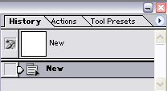
History Panel
History Panel: Photoshop automatically
saves the process of your works.
(basically 20 steps prior to the current work)
To change the number of steps it saves:
Edit > Preferences > General (History States)
.

Slide 32
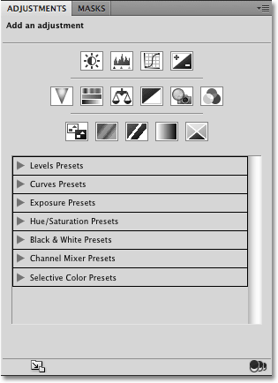
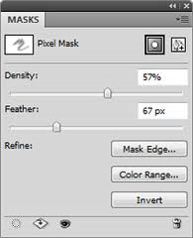
Adjustments/Masks Panels
Adjustments Panel: allows you to edit the colours, saturation, levels, brightness, contrast, vibrance, exposure, channels, mix colours, add gradients, etc.
Masks Panel: centralizes all of the tools and controls you’ll need to customize your Layer Mask in one location

Slide 33
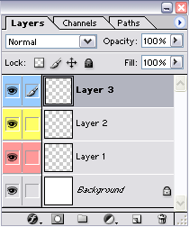
Layers Panel
Layers Panel: Separates each step of
your works from others.
By making layers and working different
steps on each layer, you can make
separate effects on each layer.

Slide 34
Understanding Layers
A layer is literally what it sounds like: one layer on top of another, all of which can be edited independently of each other and laid on top of or beneath one another, and then later combined to form a single, flat image.
When you first create an image, you will be working with the “Background” layer. You cannot always use all effects on a background layer, so you may wish to start working directly with normal layers.

Slide 35
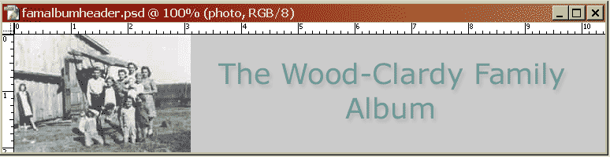
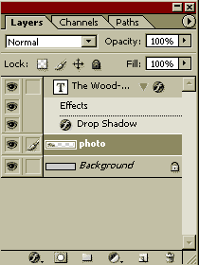
Layer basics
Layers are like sheets of glass stacked on top of each other
From top to bottom:
  Text layer
  Text effect/Drop shadow
  Photo at left
  Gray background
L-click and drag layers to move them up or down
Notes:
read

Slide 36
Layer basics
Visibility off/on toggle
Selected layer
New layer/Drag here to copy
effects
Drag here to delete
Notes:
read

Slide 37
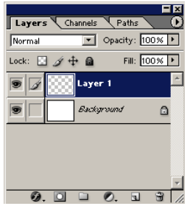
Layer basics
You will notice that “Layer 1” is above “Background” in the window. This means that anything that’s on Layer 1 will take priority over anything in the Background layer. Things in the Background layer will be obscured by things in Layer 1.
Why would you want to do this? You can switch back and forth between layers to move items independently of items in other layers, allowing you to lay things out exactly as you want.

Slide 38
Layer basics
Layers can be repositioned in different orders in the Layers palette by clicking on a layer and dragging it to a new position in the palette.
Only a selected layer can be edited. To select a layer, click on the layer name in the palette.

